Slide 1

Welcome to the AHCCCS Pharmacy and Therapeutics Committee
While you are waiting TEST YOUR AUDIO.
LISTEN FOR MUSIC.
You were automatically muted upon entry.

Slide 2
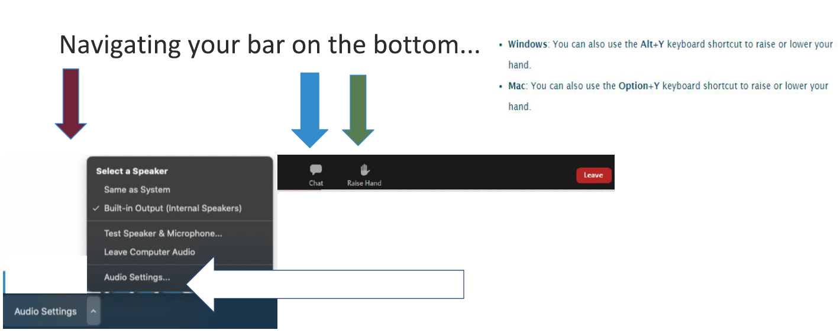
Zoom Webinar Controls

Slide 3
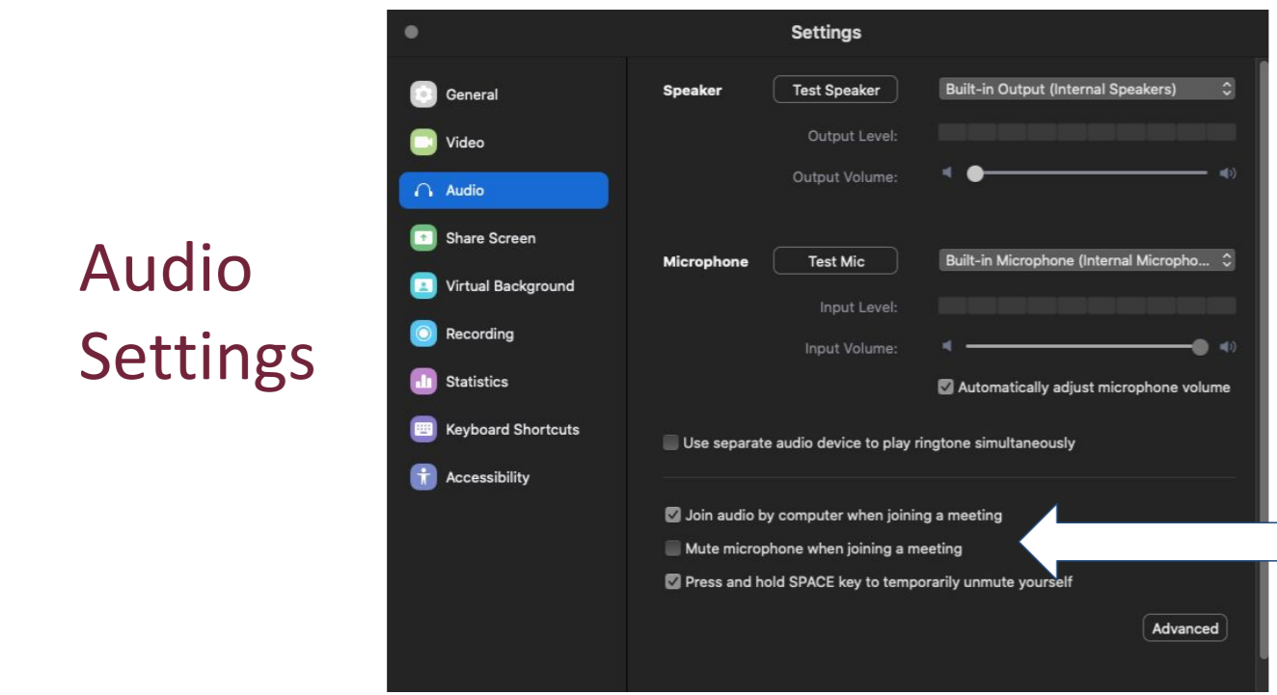

Slide 4
AHCCCS Pharmacy and Therapeutics Committee
January 26, 2021

Slide 5
Welcome and Introductions
Sara Salek, MD, Chief Medical Officer, AHCCCS
  Meeting October 14, 2020
  Review
  Vote

Slide 6
Magellan Class Reviews
Classes for Review
Androgenic Agents
Antidepressants, Other
Antidepressants, SSRIs
Antivirals, Topical
Bronchodilators, Beta Agonists
Bone Resorption Suppression and Related Agents
Colony Stimulating Factors
Enzyme Replacement, Gaucher Disease
Erythropoiesis Stimulating Proteins
Hypoglycemics, Alpha Glucosidase Inhibitors
Hypoglycemics, Metformins
Hypoglycemics, SGLT2s
Immune Globulins
Oncology, Oral – Hematologic
Ophthalmics, Anti-inflammatory/Immunomodulators
Otic Antibiotics
PAH Agents, Oral and Inhaled
Thrombopoiesis Stimulating Agents
Ulcerative Colitis

Slide 7
Magellan Drug Class Reviews
Hind Douiki, Pharm.D.

Slide 8
Androgenic Agents

Slide 9
Androgenic Agents
Drug | Manufacturer | Indications
testosterone gel (Androgel®) | generic, Abbvie | Testosterone replacement therapy in males for conditions associated with a deficiency or absence of endogenous testosterone, such as primary or secondary hypogonadism (congenital or acquired)*
testosterone gel (Fortesta®) | generic, Endo
testosterone gel (Testim®) | generic, Auxilium/Endo
testosterone gel (Vogelxo®) | generic, Upsher-Smith
testosterone nasal gel (Natesto™) | Aytu Bioscience
testosterone solution | generic
testosterone transdermal system (Androderm®) | Allergan

Slide 10
Androgenic Agents
Male hypogonadism is caused by insufficient production of testosterone and characterized by low serum concentrations
Hypogonadism may present as testosterone deficiency, infertility, or both
Transdermal delivery of testosterone is appealing to some patients as it is convenient to use and eliminates frequent office visits often required by injectable testosterone
The 2002 treatment guidelines for hypogonadism published by the American Association of Clinical Endocrinologists (AACE) advise that testosterone replacement therapy can enable the patient to function in a more normal manner and decrease the risk of future associated problems
They do not list a preferred method of delivery for testosterone replacement

Slide 11
Androgenic Agents
The 2018 Endocrine Society (ES) treatment guidelines for hypogonadism recommend a diagnosis of hypogonadism be made only if the patient has symptoms of testosterone deficiency, with clear and consistently low serum testosterone (T) levels
Serum testosterone, hematocrit, and prostate cancer risk should be monitor during the first year of treatment
The ES provides advantages and disadvantages of each formulation, but no preference for any testosterone replacement product is provided
Choice of formulation should be based on patient preference and drug pharmacokinetics, adverse effect profile, treatment burden, and cost

Slide 12
Androgenic Agents
The 2018 American Urological Association (AUA) provides a treatment algorithm for evaluating and managing testosterone deficiency
Topical and injectable formulations can be considered without preference for 1 product over another
In 2020, the American College of Physicians (ACP) published a clinical guideline on testosterone treatment for adult men with age-related low testosterone to improve sexual function
They recommend against initiating testosterone therapy for improvement of energy, vitality, physical function, or cognition in men with age-related low T

Slide 13
Androgenic Agents
In May 2009, FDA issued a safety alert for testosterone gel products, Androgel and Testim, due to reports of children experiencing adverse effects after unintended exposure to testosterone through contact with individuals being treated with these agents
As a result, all gel and solution products (Androgel, Fortesta, Testim, Vogelxo, and testosterone solution) carry a boxed warning on virilization of children following secondary exposure
The FDA has issued a warning that prescription testosterone products are approved only for men who have low testosterone levels caused by certain medical conditions
The FDA has also concluded that there is a possible increased cardiovascular risk associated with testosterone use

Slide 14
Androgenic Agents
In response, AACE/American College of Endocrinology (ACE) issued a position statement indicating that the correlation of cardiovascular risk may be due to low testosterone serving as a marker of cardiovascular disease rather than testosterone supplementation as a causative factor
The gel and solution formulations of testosterone, however, do demonstrate a lower incidence of adverse reactions related to administration compared to the patches
All testosterone products are Schedule III controlled substances

Slide 15
Antidepressants, Other

Slide 16
Antidepressants, Other
Drug | Manufacturer | Major Depressive Disorder (MDD) | Generalized Anxiety Disorder (GAD) | Social Anxiety Disorder (SAD) | Panic Disorder | Other Indications
bupropion HBr (Aplenzin®) | Valeant/Bausch | X | -- | -- | -- | --
bupropion HCl ER (Forfivo XL®) | generic*, Almatica | X | -- | -- | -- | --
bupropion HCl ER (Wellbutrin® XL) | generic, Valeant/Bausch | X | -- | -- | -- | prevention of major depressive episodes associated with seasonal affective disorder
bupropion HCl IR | generic | X | -- | -- | -- | --
bupropion HCl SR (Wellbutrin® SR) | generic, GlaxoSmithKline | X | -- | -- | -- | --
desvenlafaxine ER base | Ranbaxy/Sun | X | -- | -- | -- | --

Slide 17
Antidepressants, Other
desvenlafaxine succinate ER (Pristiq®) | generic, Wyeth/Pfizer | X | -- | -- | -- | --
duloxetine (Cymbalta®) | generic, Eli Lilly | X | X | -- | -- | diabetic peripheral neuropathic pain; fibromyalgia; chronic musculoskeletal pain
duloxetine delayed-release (Drizalma Sprinkle™) | Sun | X | X | -- | -- | diabetic peripheral neuropathic pain; chronic musculoskeletal pain
esketamine‡ (Spravato™) | Janssen | X treatment-resistant depression (TRD); depressive symptoms with acute suicidal ideation or behavior | -- | -- | -- | --
isocarboxazid (Marplan®) | Medilink/Validus | X 2nd line therapy | -- | -- | -- | --
levomilnacipran (Fetzima®) | Allergan/Forest | X | -- | -- | -- | --
mirtazapine tablet and ODT (Remeron®; Remeron SolTab), | generic, Merck/Organon | X | -- | -- | -- | --

Slide 18
Antidepressants, Other
nefazodone | Teva | X | -- | -- | -- | --
phenelzine (Nardil®) | generic, Pfizer | X 2nd line therapy | -- | -- | -- | --
selegiline (Emsam®) | Mylan Specialty | X | -- | -- | -- | --
tranylcypromine (Parnate®) | generic, Concordia | X 2nd line therapy | -- | -- | -- | --
trazodone | generic | X | -- | -- | -- | --
venlafaxine | generic | X | -- | -- | -- | --
venlafaxine ER capsule (Effexor XR®) | generic, Wyeth/Pfizer | X | X | X | X | --
[i] Nefazodone [package insert]. Sellersville, PA; Teva; January 2016September 2015.
[ii] Nardil [package insert]. New York, NY; Pfizer; August 2018.
[iii] Emsam [package insert]. Morgantown, WV; Mylan; July 2017.
[iv] Parnate [package insert]. St. Michael, Barbados; Concordia; May September 2019.
[v] Trazodone [package insert]. Weston, FL; Apotex; November 2018.
[vi] Venlafaxine [package insert]. Rockford, IL; Mylan; January 2019.
[vii] Effexor XR [package insert]. Philadelphia, PA; Wyeth; December 2018.

Slide 19
Antidepressants, Other
venlafaxine ER tablet (Venlafaxine ER) | generic, Trigen | X | -- | X | -- | --
vilazodone HCl (Viibryd®) | Allergan | X | -- | -- | -- | --
vortioxetine (Trintellix®§) | Takeda | X | -- | -- | -- | --
[i] Nefazodone [package insert]. Sellersville, PA; Teva; January 2016September 2015.
[ii] Nardil [package insert]. New York, NY; Pfizer; August 2018.
[iii] Emsam [package insert]. Morgantown, WV; Mylan; July 2017.
[iv] Parnate [package insert]. St. Michael, Barbados; Concordia; May September 2019.
[v] Trazodone [package insert]. Weston, FL; Apotex; November 2018.
[vi] Venlafaxine [package insert]. Rockford, IL; Mylan; January 2019.
[vii] Effexor XR [package insert]. Philadelphia, PA; Wyeth; December 2018.

Slide 20
Antidepressants, Other
In the US, approximately 17.3 million adults, or 7.1% of the adult population, have reported the prevalence of depression in 2017
The 2010 American Psychiatric Association (APA) treatment guidelines for patients with MDD recommend an SSRI, SNRI, mirtazapine, and bupropion as appropriate for initial treatment of most patients
Adverse event and safety profiles of TCAs and MAOIs have greatly reduced their use as first-line agents
According to the World Federation of Societies of Biological Psychiatry (WFSBP) guidelines on unipolar depression from 2013 and 2015, no single class of antidepressants has proven to be more effective or have a more rapid onset than another
However, limited data suggest that select TCAs and venlafaxine may be slightly more effective in severely depressed hospitalized patients

Slide 21
Antidepressants, Other
Treatment-resistant depression (TRD) occurs in approximately 20% to 30% of patients with MDD.
When response is inadequate with trial of a first-line therapy, strategies for treatment include maximizing the dose, switching to another class or another drug within the class, combination therapy [e.g., multiple drugs or drug plus psychotherapy), augmentation, or other nonpharmacologic therapy (e.g., light therapy, electroconvulsive therapy in select patients]
Per the 2016 American College of Physicians (ACP) guidelines, treatment with either CBT or second-generation antidepressants for MDD is recommended
Non-SSRI antidepressants are most often used as first-line therapy in children in the presence of comorbidities, such as attention-deficit/hyperactivity disorder (ADHD), where bupropion may be more effective than an SSRI
In 2018, the North American Menopause Society and National Network on Depression Centers published consensus guidelines for the treatment of perimenopausal depression

Slide 22
Antidepressants, Other
These note that SSRIs and SNRIs, particularly desvenlafaxine, have been shown to improve menopause-associated symptoms [e.g., vasomotor symptoms, pain, sleep disturbances, night sweats); however, none of the agents in this class are approved for symptoms of menopause]
The 2008 WFSBP guidelines recommend SSRIs, SNRIs, and pregabalin as first-line therapies for the treatment of anxiety, obsessive-compulsive, and post-traumatic stress disorders [CBT and other variants of behavior therapy are recommended either alone or in combination with these medications]
The 2009 American Psychiatric Association (APA) treatment guidelines recommend SSRIs, SNRIs, TCAs, and benzodiazepines as first-line pharmacotherapy for panic disorder
For Seasonal Affective Disorder, the International Consensus Group on Depression and Anxiety (ICGDA) expert panel guidelines recommend SSRIs as first-line therapy

Slide 23
Antidepressants, Other
All of the antidepressants have a boxed warning regarding suicidality in children, adolescents, and young adults
Tranylcypromine (Parnate) also carries a boxed warning informing that excessive consumption of foods or beverages that contain significant amounts of tyramine can precipitate hypertensive crisis
Esketamine (Spravato) also carries a boxed warning for risk of dissociation and sedation after administration as well as abuse and misuse
Use of esketamine requires enrollment in the Spravato REMS program
Effectiveness is generally comparable among classes and within classes of antidepressants
Pharmacotherapy should be selected based on adverse event profiles, co-morbidities, drug interactions, pharmacokinetics, patient preference, cost, and historical patient response

Slide 24
Antidepressants, SSRIs

Slide 25
Antidepressants, SSRIs
Drug | Mfr | MDD | GAD | SAD | Panic Disorder | PTSD | OCD | PMDD | Bulimia Nervosa | VMS
citalopram (Celexa®) | generic, Allergan | X | -- | -- | -- | -- | -- | -- | -- | --
escitalopram (Lexapro®) | generic, Allergan | X (≥ 12 years) | X | -- | -- | -- | -- | -- | -- | --
fluoxetine | generic, Alvogen | X (≥ 8 years) | -- | -- | X | -- | X (≥ 7 years) | -- | X | --
fluoxetine (Prozac®) | generic, Dista | X (≥ 8 years) | -- | -- | X | -- | X (≥ 7 years) | -- | X | --
fluoxetine (Sarafem®) | generic, Actavis/ Allergan | -- | -- | -- | -- | -- | -- | X | -- | --

Slide 26
Antidepressants, SSRIs
Drug | Mfr | MDD | GAD | SAD | Panic Disorder | PTSD | OCD | PMDD | Bulimia Nervosa | VMS
fluoxetine ER | generic | X | -- | -- | -- | -- | -- | -- | -- | --
fluvoxamine | generic, ANI | -- | -- | -- | -- | -- | X (≥ 8 years) | -- | -- | --
fluvoxamine ER | Dr. Reddy’s | -- | -- | -- | -- | -- | X | -- | -- | --

Slide 27
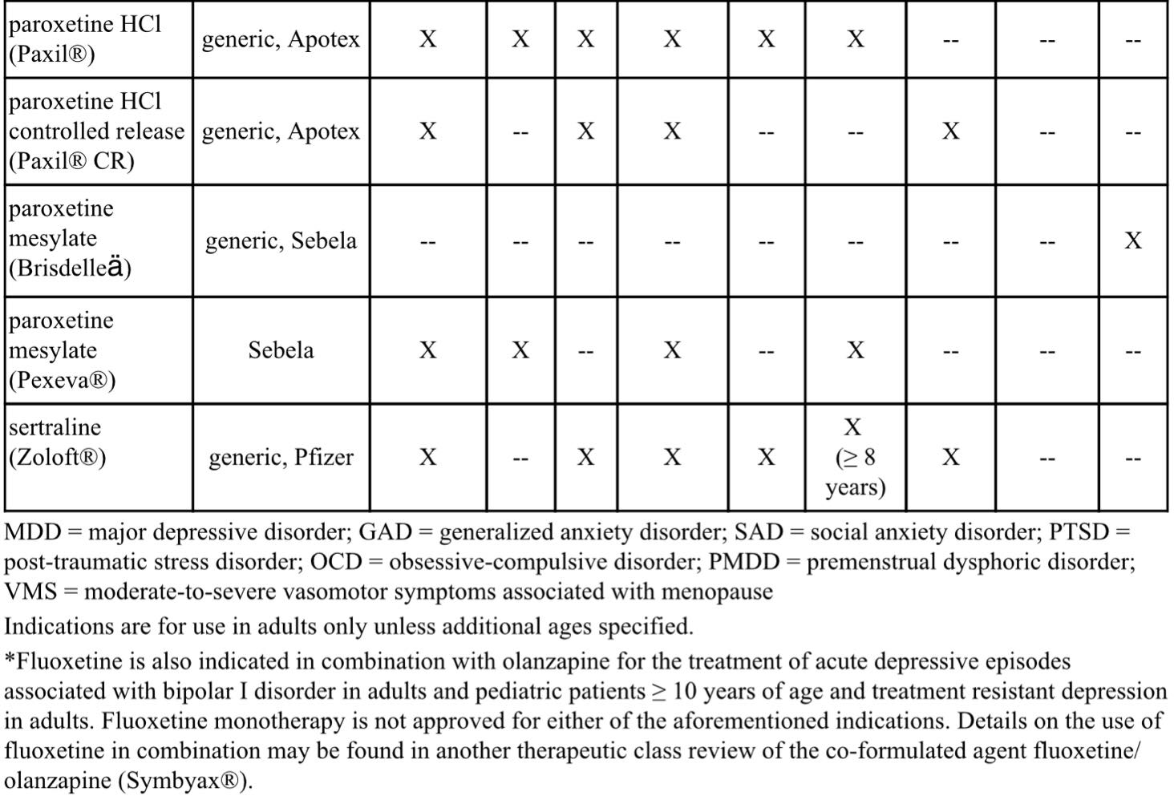
Antidepressants, SSRIs

Slide 28
Antidepressants, SSRIs
SSRIs are generally considered first-line therapy for their FDA-approved indications due to improved tolerability, lower lethality in overdose, safety in cardiovascular disease, and lesser incidence of weight gain
SSRIs have comparable efficacy and adverse event profiles for their FDA-approved indications
SSRIs are preferred as a first medication trial for OCD

Slide 29
Antidepressants, SSRIs
SSRIs are the recommended first-line medications for the treatment of PTSD
Fluoxetine (Prozac) is the only SSRI medication approved by the FDA for the treatment of bulimia and has been shown to reduce the episodes of binge-eating and purging behavior, and their chance of relapse
SSRIs are used most often for the treatment of children with MDD because studies of SSRIs were the first to show antidepressant efficacy in children
SSRIs are also first-line agents for the treatment of anxiety disorders in children. Four of the products are approved for pediatric use: escitalopram, fluoxetine, fluvoxamine, and sertraline

Slide 30
Antidepressants, SSRIs
Product/guideline updates:
Allergan has made a business decision to discontinue Sarafem tablets. Generic formulations will remain available

Slide 31
Antivirals, Topical

Slide 32
Antivirals, Topical
Drug | Manufacturer | Indication(s)
acyclovir cream (Zovirax®) | generic, Valeant | Treatment of recurrent herpes labialis (cold sores) in immunocompetent adults and children 12 years of age and older
acyclovir ointment (Zovirax®) | generic, Valeant | Management of initial genital herpes and in limited non-life-threatening mucocutaneous herpes simplex virus infections in immunocompromised adult patients
acyclovir/ hydrocortisone (Xerese®) | Valeant | Early treatment of recurrent herpes labialis (cold sores) to reduce the likelihood of ulcerative cold sores and to shorten the lesion healing time in adults and children 6 years of age and older
docosanol (Abreva®) | generic, GlaxoSmithKline | Treatment of cold sores/fever blisters on the face or lips in adults and children 12 years of age and older to shorten healing time and duration of symptoms
penciclovir (Denavir®) | Mylan | Treatment of recurrent herpes labialis (cold sores) in adults and children 12 years of age and older

Slide 33
Antivirals, Topical
The HSV-1 and HSV-2 viruses become reactivated secondary to certain stimuli including fever, upper respiratory infection, physical or emotional stress, ultraviolet light exposure, and axonal injury
Topical antiviral medications are used for the treatment of an active lesion and should be started during the prodrome phase, characterized by perioral tingling, itching, and redness, to be most beneficial
Overall, acyclovir, penciclovir, and docosanol for herpes labialis treatment only provide modest benefit if used very early in the prodrome phase.
Compared to placebo, treatment has reduced lesion healing time by approximately 0.75 to 1.5 days in clinical trials

Slide 34
Antivirals, Topical
Left untreated, herpes labialis may take up to 10 days or more to heal
According to studies, all products are effective in treating herpes labialis and provide symptom relief, such as decreased lesion count, lesion size, pain, and healing time compared to placebo
The 2015 Centers for Disease Control and Prevention (CDC) sexually-transmitted disease (STD) recommendations for genital herpes state oral antiviral therapy is preferred over topical antiviral therapy

Slide 35
Bronchodilators, Beta Agonist

Slide 36
Bronchodilators, Beta Agonists
Class Overview: Long-Acting Agents
aformoterol tartrate - (Brovana Solution)
formoterol fumarate - (Perforomist Solution)
indacaterol maleate - (Arcapta Neohaler)*
olodaterol HCl - (Striverdi Respimat)
salmeterol xinafoate - (Serevent Diskus)
Class Overview: Nebulized Agents
albuterol sulfate - (AccuNeb; albuterol neb soln 0.63mg & 1.25mg, 2.5mg/0.5ml, 2.5mg/3ml & 5mg/ml)
levalbuterol HCl – (levalbuterol neb soln; levalbuterol neb soln conc; Xopenex Neb Soln)
*In March 2020, Sunovion reported to the FDA the discontinuation of indacaterol (Arcapta Neohaler) production. Product may remain available until supply is depleted

Slide 37
Bronchodilators, Beta Agonists
Class Overview: Oral Agents
albuterol sulfate - (albuterol ER, syrup & tablet)
metaproterenol sulfate - (metaproterenol syrup & tablet)
terbutaline sulfate - (terbutaline)
Class Overview: Short-Acting Agents
albuterol sulfate - (ProAir Digihaler; ProAir HFA; ProAir Respiclick; Proventil HFA; Ventolin HFA)
levalbuterol tartrate - (Xopenex HFA)

Slide 38
Bronchodilators, Beta Agonists
Prevalence and incidence of asthma in the U.S. continues to rise, affecting approximately 7.7% of adults and 8.4% of children (25.2 million Americans)
It is estimated that the number of Americans with a COPD diagnosis is approximately 16 million
Beta₂-agonist bronchodilators are used for the treatment and prevention of bronchospasm associated with asthma, prophylaxis of exercise-induced bronchospasm (EIB), and in the treatment of Chronic Obstructive Lung Disease (COPD)
Mainstay of asthma therapy is the use of inhaled corticosteroids (ICS) alone or in combination with long-acting beta₂-agonists (LABAs) as controller medications
These agents lead to improvements in symptoms, reducing the need for short-acting beta₂-agonists (SABAs) for quick relief by relaxing airway smooth muscle

Slide 39
Bronchodilators, Beta Agonists
Due to the increased risk of severe exacerbations with regular or frequent use, short-acting beta agonist (SABA)-only treatment is no longer recommended
For most asthma patients, treatment can be initiated with an as-needed low dose ICS-formoterol, daily low dose ICS, or low dose ICS taken whenever a SABA is taken
The 2020 GINA guidelines offer a control-based management plan which adjusts treatment through a continuous cycle of assessment and review of the patient’s response to therapy as it relates to symptom control, future risk of exacerbations, and side effects
The 2020 GOLD guidelines place a great focus on the assessment of inhaler technique and adherence to improve therapeutic outcomes
In August 2020, Choosing Wisely, an initiative of the American Board of Internal Medicine (ABIM), released guidance for the management of pediatric asthma based on information from the American Academy of Pediatrics

Slide 40
Bronchodilators, Beta Agonists
Choosing Wisely recommends a thorough evaluation of medication adherence, technique, and device appropriateness prior to stepping up asthma therapy in this patient population
the guidance recommends against the use of LABA/ICS combination inhalers as initial therapy in pediatric patients with intermittent or mild persistent asthma and state that typically a single agent, such as a low-dose ICS or leukotriene modifier, is sufficient to maintain asthma control
In 2020, the American Thoracic Society (ATS) released additional guidelines for the pharmacologic management of COPD
The panel strongly recommends the use of dual LABA/LAMA therapy over LABA or LAMA monotherapy in COPD patients who complain of exercise intolerance or dyspnea
in patients who complain of dyspnea or exercise intolerance despite dual therapy with LABA/LAMA, the ATS suggests triple therapy (ICS/LABA/LAMA) in patients with a history of ≥ 1 exacerbations requiring hospitalization, oral steroids, or antibiotics in the past year
ATS recommends against maintenance oral corticosteroid therapy in patients with frequent and severe exacerbations while on optimal therapy

Slide 41
Bronchodilators, Beta Agonists
For patients receiving triple combination therapy who experience no exacerbations over the course of 1 year, the ATS suggests that ICS therapy may be discontinued
COPD pharmacotherapy of bronchodilators is intended to decrease symptoms, reduce the frequency and severity of exacerbations, improve health status and exercise tolerance
Bronchodilator medications are central to management of COPD. They improve emptying of the lungs, reduce dynamic hyperinflation at rest and during exercise, and improve exercise performance
Bronchodilators are given either on an as-needed basis for relief of persistent or worsening symptoms, or on a regular basis to prevent/reduce symptoms
Regular bronchodilation does not modify the decline of lung function in mild COPD or the prognosis of the disease

Slide 42
Bronchodilators, Beta Agonists
While short-acting beta agonists (SABAs) can be used on an as-needed basis in mild COPD, regular treatment with a long-acting beta agonist (LABA) is required as the disease progresses
Delivery system selection as well as the patients’ ability to properly use the device are important factors in the clinical success of bronchodilator therapy
Metered dose inhalers (MDIs) are pressurized spray inhalers, available in suspension and solution
Spacer chambers may be used with most MDIs to make them easier to use and help deliver a greater amount of medicine to the airway
Dry-powder inhalers (DPIs) are breath-actuated devices that release the medicine in the form of a dry powder upon inhalation

Slide 43
Bronchodilators, Beta Agonists
Nebulizers, may be the only viable alternative delivery system for certain children and those unable to use inhalers due to the inability to synchronize breaths and device actuation
Some of the newer delivery devices, (like Respimat devices), are not breath-activated, but still require coordination of actuation and inhalation
Oral dosage forms of albuterol are less utilized than the inhaled forms due to systemic beta-adrenergic stimulation, especially in patients sensitive to these effects, such as those with cardiovascular disease
Levalbuterol has similar efficacy to albuterol and there are no significant differences in adverse effects

Slide 44
Bronchodilators, Beta Agonists
Salmeterol has a later onset of action than the rest of the LABAs
There are no comparative data to suggest that arformoterol (Brovana) or formoterol (Perforomist) are superior in efficacy or safety to the other agents
In May 2019, the FDA removed the boxed warning from the labeling for indacaterol (Arcapta Neohaler), arformoterol (Brovana), formoterol (Perforomist), and olodaterol (Striverdi). The warning still remains in the labeling of salmeterol (Serevent Diskus).
For most asthma patients, treatment can be initiated with an as-needed low dose ICS-formoterol, daily low dose ICS, or low dose ICS taken whenever SABA is taken

Slide 45
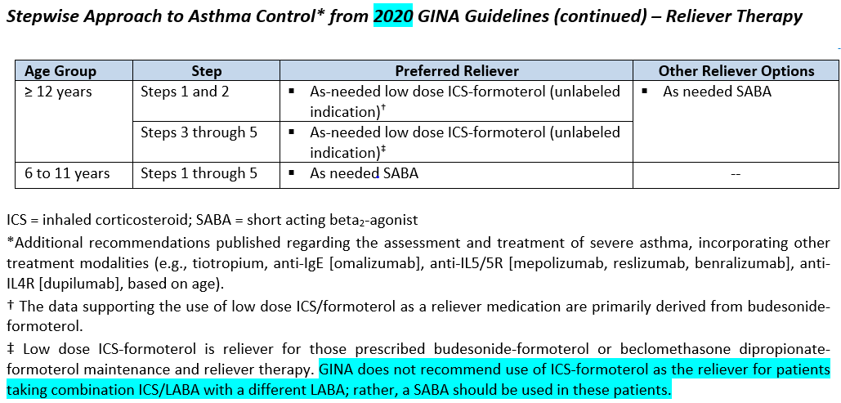
Bronchodilators, Beta Agonists

Slide 46
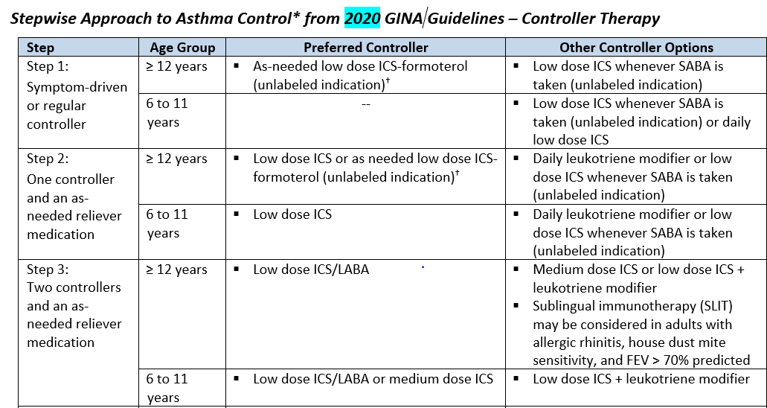
Bronchodilators, Beta Agonists

Slide 47
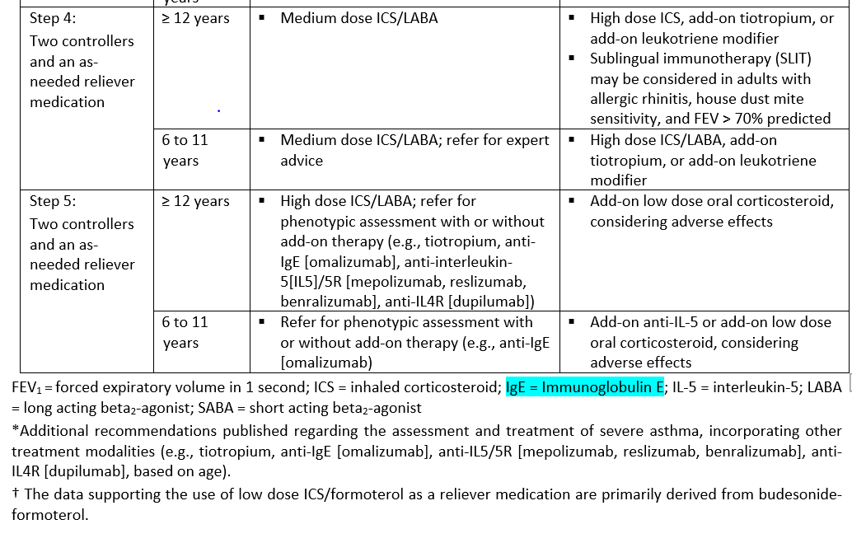
Bronchodilators, Beta Agonists

Slide 48
Bronchodilators, Beta Agonists
2020 GOLD Guidelines
Assessment of Airflow Limitation
Gold 1 | Mild, FEV1 ≥ 80% predicted
Gold 2 | Moderate, FEV1 50% to 79% predicted
Gold 3 | Severe, FEV1 30% to 49% predicted
Gold 4 | Very severe, FEV1 < 30% predicted

Slide 49
Bronchodilators, Beta Agonists
2020 GOLD Guidelines
Assessment of Exacerbation Risk and Symptoms
Patient Group A | Low Risk, Less Symptoms: 0 to 1 exacerbations per year (not leading to hospitalization); and CAT score < 10 or mMRC grade 0 to 1
Patient Group B | Low Risk, More Symptoms: 0 to 1 exacerbations per year (not leading to hospitalization); and CAT score ≥ 10 or mMRC grade ≥ 2
Patient Group C | High Risk, Less Symptoms: ≥ 2 exacerbations per year or ≥ 1 exacerbation leading to hospitalization; and CAT score < 10 or mMRC grade 0 to 1
Patient Group D | High Risk, More Symptoms: ≥ 2 exacerbations per year or ≥ 1 exacerbation leading to hospitalization; and CAT score ≥ 10 or mMRC grade ≥ 2
mMRC - Modified British Medical Research Council questionnaire used only to assesses breathlessness

Slide 50
Bone Resorption Suppression and Related Agents

Slide 51
Bone Resorption Suppression and Related Agents
^{[i]} Binosto [package insert]. San Antonio, TX; Mission Pharmacal; December 2016.
[ii] Fosamax [package insert]. Whitehouse Station, NJ; Merck; March 2016.
[iii] Fosamax Plus D [package insert]. Whitehouse Station, NJ; Merck; March 2016.
[iv] Didronel [package insert]. Rockaway, NJ; Warner Chilcott; April 2015.
[v] Boniva [package insert]. Nutley, NJ; Roche; December 2016.
[vi] Actonel [package insert]. Rockaway, NJ; Warner Chilcott; April 2015.
[vii] Atelvia [package insert]. Rockaway, NJ; Warner-Chilcott; April 2015.
Drug | Manufacturer | Indication(s)
Bisphosphonates
alendronate (Binosto®) | Mission, Ascend | Treatment and prevention of osteoporosis in postmenopausal women Treatment to increase bone mass in men with osteoporosis
alendronate* (Fosamax®) | generic, Merck | Treatment and prevention of osteoporosis in postmenopausal women Treatment to increase bone mass in men with osteoporosis Treatment of glucocorticoid-induced osteoporosis in men and women receiving glucocorticoids in a daily dosage equivalent of 7.5 mg or greater of prednisone and who have low bone mineral density Treatment of Paget’s disease of bone in men and women
alendronate/ vitamin D (Fosamax® Plus D) | Merck | Treatment of osteoporosis in postmenopausal women Treatment to increase bone mass in men with osteoporosis
etidronate | generic | Treatment of Paget’s disease of bone Prevention and treatment of heterotopic ossification following total hip replacement or spinal cord injury
ibandronate (Boniva®) | generic, Roche | Treatment and prevention of osteoporosis in postmenopausal women
risedronate† (Actonel®) | generic, Actavis/Allergan | Treatment and prevention of osteoporosis in postmenopausal women Treatment to increase bone mass in men with osteoporosis Prevention and treatment of glucocorticoid-induced osteoporosis in men and women who are either initiating or continuing systemic glucocorticoids in a daily dosage equivalent of 7.5 mg or greater of prednisone for chronic diseases Treatment of Paget’s disease of bone in men and women
risedronate delayed-release (Atelvia®) | generic, Actavis/Allergan | Treatment of osteoporosis in postmenopausal women

Slide 52
Bone Resorption Suppression and Related Agents
Drug | Manufacturer | Indication(s)
Others
abaloparatide (Tymlos®) | Radius Health | Treatment of osteoporosis in postmenopausal women who are at high risk for fractures
denosumab (Prolia®) | Amgen‡ | Treatment of osteoporosis in postmenopausal women at high risk for fracture, defined as a history of osteoporotic fracture, or multiple risk factors for fracture, or in patients who have failed or are intolerant to other available osteoporosis therapy Treatment of osteoporosis associated with newly initiated or sustained systemic glucocorticoid therapy in men and women at high risk for fracture. Treatment of bone loss in men with prostate cancer on androgen deprivation therapy Treatment of bone loss in women undergoing breast cancer therapy with adjuvant aromatase therapy Treatment to increase bone mass in men diagnosed with osteoporosis and a high fracture risk who have failed or are intolerant to other potential therapies
raloxifene (Evista®) | generic, Eli Lilly | Treatment and prevention of osteoporosis in postmenopausal women Reduction in risk of invasive breast cancer in postmenopausal women who either have osteoporosis or are at high risk for invasive breast cancer
romosozumab-aqqg (Evenity®) | Amgen | Treatment of osteoporosis in postmenopausal women at high risk for fracture, defined as a history of osteoporotic fracture, or multiple risk factors for fracture; or patients who have failed or are intolerant to other available osteoporosis therapy

Slide 53
Bone Resorption Suppression and Related Agents
Drug | Manufacturer | Indication(s)
Others
teriparatide* | Alvogen | Treatment of osteoporosis in postmenopausal women who are at high risk for fracture Increase of bone mass in men with primary or hypogonadal osteoporosis who are at high risk for fracture Treatment of men and women with osteoporosis associated with sustained systemic glucocorticoid therapy at high risk for fracture
teriparatide (Forteo®) | Eli Lilly | Treatment of osteoporosis in postmenopausal women who are at high risk for fractures Increase of bone mass in men with primary or hypogonadal osteoporosis who are at high risk for fractures Treatment of men and women with osteoporosis associated with sustained systemic glucocorticoid therapy at high risk for fracture

Slide 54
Bone Resorption Suppression and Related Agents
Calcitonins
calcitonin-salmon | generic | Treatment of postmenopausal osteoporosis in females greater than 5 years postmenopause when alternative treatments are not suitable. Fracture reduction efficacy has not been demonstrated

Slide 55
Bone Resorption Suppression and Related Agents
Approximately 10 million Americans have a diagnosis of osteoporosis, and an additional 43 million have low bone mass, placing them at increased risk for this disease
The North American Menopause Society (NAMS), in its 2010 position statement, recommends bisphosphonates as first-line drugs to treat postmenopausal women with osteoporosis (defined as having a T-score ≤ -2.5)
The 2014 National Osteoporosis Foundation (NOF) Clinician’s Guide to Prevention and Treatment of Osteoporosis states that the treatment agent of choice should be based on available clinical information in addition to intervention thresholds
The American Association of Clinical Endocrinologists (AACE) and American College of Endocrinology (ACE) clinical practice guidelines for the diagnosis and treatment of postmenopausal osteoporosis (2020 update) recommend alendronate, risedronate, zoledronic acid, and denosumab as initial therapy for most patients at high risk of fracture

Slide 56
Bone Resorption Suppression and Related Agents
Per the AACE/ACE, teriparatide, abaloparatide, denosumab, romosozumab, or zoledronic acid should be considered for patients unable to use oral therapy and as initial therapy for patients at especially high fracture risk
According to the American College of Physicians’ (ACP) published update in 2017 for the treatment of low bone density and osteoporosis to prevent fractures in men and women, pharmacologic treatment to reduce the risk for hip and vertebral fractures in women with known osteoporosis and treatment should occur for 5 years
ACP recommends against using menopausal estrogen or estrogen with progesterone or raloxifene for osteoporosis treatment in women

Slide 57
Bone Resorption Suppression and Related Agents
Regarding therapy in men, the ACP recommends that clinicians offer treatment with bisphosphonates to reduce the risk of vertebral fractures in those with clinical osteoporosis
According to the American College of Rheumatology’s (ACR) 2017 updated guidance on managing glucocorticoid-induced osteoporosis in adults and children, treatment should include optimal calcium and vitamin D intake and lifestyle changes consistent with good bone health
ACR’s recommendations on antiresorptive treatment are based on individual patient characteristics, including fracture risk, age, and special populations
In patients with moderate to high risk of fracture, oral bisphosphonates are generally recommended as first-line therapy, per ACR; subsequent treatments may include IV bisphosphonates, teriparatide, denosumab, and raloxifene

Slide 58
Bone Resorption Suppression and Related Agents
The Endocrine Society 2020 guidelines on osteoporosis recommends pharmacologic therapy for postmenopausal women at high risk of fracture, especially those with recent fracture
These patients should be treated initially with a bisphosphonate or denosumab to reduce fracture risk; however, ibandronate is not recommended to reduce the risk of nonvertebral or hip fracture
For postmenopausal women with a very high risk of fracture, these guidelines recommend starting with either teriparatide or abaloparatide for up to 2 years of treatment before switching to a bisphosphonate or denosumab to maintain bone density
The 2020 ES guidance also included Evenity, which was concluded to be a potential treatment option for select postmenopausal women at very high risk of fracture, but patients should be carefully evaluated due to the serious potential cardiovascular events
After completing a course of romosozumab-aqqg, it is recommended that patients receive treatment with antiresorptive therapies to maintain gains in bone density and reductions in fracture risk

Slide 59
Bone Resorption Suppression and Related Agents
Raloxifene, calcitonin, and hormone replacement therapy are only recommended if patients are not appropriate candidates for treatment with bisphosphonates or denosumab
Clinical trials have shown a decreased risk of fractures with alendronate (Fosamax), calcitonin- salmon, ibandronate (Boniva), raloxifene (Evista), risedronate (Actonel, Atelvia), denosumab (Prolia) and teriparatide (Forteo) in women with osteoporosis
Teriparatide (Forteo) showed the greatest increase in BMD in clinical trials, ranging from 5% to more than 10%; bisphosphonates increased BMD about 2% to 5%; calcitonin and raloxifene (Evista) trials showed BMD increases of approximately of 1% to 2%
When compared to once-weekly regimens, once-monthly dosing regimens do not appear to give rise to greater treatment adherence and persistence
Romosozumab-aqqg (Evenity) labeling carries a boxed warning for an increased risk of major adverse cardiac events (MACE) including myocardial infarction (MI), stroke, and cardiovascular death

Slide 60
Bone Resorption Suppression and Related Agents
Product/guideline updates:
American Society for Bone and Mineral Research, American Association of Clinical Endocrinologists, Endocrine Society, European Calcified Tissue Society, and National Osteoporosis Foundation issued a joint statement on the management of osteoporosis during COVID-19 pandemic
Oral bisphosphonate therapy should not be delayed and patients already taking the medication should continue treatment
BMD exams may need to be delayed and standard pretreatment lab work for IV bisphosphates or denosumab may be skipped if results in prior year were normal
Alternative methods of delivering parenteral medications for osteoporosis may be considered or temporarily delaying denosumab, teriparatide, abaloparatide, or romosozumab may be considered in patients who are unable to receive prescribed therapy
Patients may need to temporarily transition to oral bisphosphonates if denosumab dose is delayed by ≥ 1 month or if teriparatide, abaloparatide, or romosozumab dose is delayed by > 2-3 months

Slide 61
Colony Stimulating Factors

Slide 62
Colony Stimulating Factors
Drug | Manufacturer | Cancer patients receiving myelosuppressive chemotherapy (To reduce incidence of infection (febrile neutropenia) | Acute Myeloid Leukemia (AML) patients receiving chemotherapy (Following induction or consolidation chemotherapy to reduce time to neutrophil recovery and the duration of fever in adults) | Bone Marrow Transplant (BMT) | Peripheral Blood Progenitor Cell Collection and Therapy | Severe Chronic Neutropenia (To reduce the incidence and duration of neutropenia in symptomatic patients with congenital neutropenia, cyclic neutropenia, or idiopathic neutropenia) | Hematopoietic Syndrome of Acute Radiation Syndrome (To Increase survival in patients acutely exposed to myelosuppressive doses of radiation)
filgrastim (Neupogen®) | Amgen | X | X | Xª | X | X | X
filgrastim-aafi (Nivestym™)* | Pfizer | X | X | Xª | X | X | --
filgrastim-sndz (Zarxio®)* | Sandoz | X | X | Xª | X | X | --
pegfilgrastim (Neulasta®) | Amgen | X | -- | -- | -- | -- | X

Slide 63
Colony Stimulating Factors
pegfilgrastim-apgf (Nyvepria™) | Pfizer | X | -- | -- | -- | -- | --
pegfilgrastim-cbqv (Udenyca™) | Coherus | X | -- | -- | -- | -- | --
pegfilgrastim-jmdb (Fulphila™) | Mylan | X | -- | -- | -- | -- | --
pegfilgrastim-bmez (Ziextenzo™) | Sandoz | X | -- | -- | -- | -- | --
sargramostim (Leukine®) | Sanofi/Partner | -- | X | X^{b} | X | -- | X
tbo-filgrastim (Granix®) | Cephalon/Teva | X | -- | -- | -- | -- | --

Slide 64
Colony Stimulating Factors
Colony stimulating factors (CSF) are hematopoietic growth factors that have been shown to decrease the likelihood of chemotherapy-induced neutropenic complications and to improve relative chemotherapy dose intensity
Prophylactic CSF use can reduce the severity, risk, and duration of febrile neutropenia and decrease rates of infection
Filgrastim (Neupogen), filgrastim-aafi (Nivestym), filgrastim-sndz (Zarxio), pegfilgrastim (Neulasta), pegfilgrastim-cbqv (Udenyca), pegfilgrastim-jmdb (Fulphila), pegfilgrastim-bmez (Ziextenzo), and tbo-filgrastim (Granix) are granulocyte colony-stimulating factors (G-CSF)
Sargramostim (Leukine) is a granulocyte-macrophage colony stimulating factor (GM-CSF).
Limited comparative data suggest that filgrastim (Neupogen) and pegfilgrastim (Neulasta) have similar efficacy, tolerability, and adverse drug reaction profiles

Slide 65
Colony Stimulating Factors
The administration frequency of pegfilgrastim and its biosimilars may be viewed as more favorable since these only require a single SC injection per chemotherapy cycle; whereas filgrastim, filgrastim-aafi (Nivestym), filgrastim-sndz (Zarxio), tbo-filgrastim (Granix), and sargramostim (Leukine) administration requires daily subcutaneous injection
Several biosimilars to the originator products, filgrastim (filgrastim-aafi and filgrastim-sndz) and pegfilgrastim (pegfilgrastim-cbqv, pegfilgrastim-bmez, pegfilgrastim-apgf, pegfilgrastim-jmdb, and pegfilgrastim-apgf ) are now available
The v2.2020 NCCN practice guidelines for hematologic growth factors indicate there is higher level evidence supporting the use of filgrastim, filgrastim-aafi, filgrastim-sndz, tbo-filgrastim, and pegfilgrastim (category 1) for prophylactic use against febrile neutropenia
Pegfilgrastim-cbqv and pegfilgrastim-jmdb are rated a category 2A and sargramostim is no longer recommended in this setting

Slide 66
Colony Stimulating Factors
A recommendation for the recently approved pegfilgrastim-bmez (Ziextenzo) is not currently provided by NCCN
The guidelines note that biosimilars are biological products that are highly similar to their FDA-approved originator product with very small, clinically inactive differences but have no difference in efficacy, safety, or purity.
At this time there are insufficient head-to-head comparative studies on the clinical benefits of G-CSFs and GM-CSFs
The NCCN guidelines do not recommend CSF use in patients taking chemotherapy and radiation concurrently
NCCN guidelines recommend that high-risk patients receive prophylactic CSF regardless of the intent of treatment

Slide 67
Colony Stimulating Factors
For intermediate-risk patients, NCCN recommends individualized consideration of CSF based on the likelihood of developing febrile neutropenia, consequences of developing febrile neutropenia, and the implications of interfering with chemotherapy treatments
NCCN does not recommend the routine use of CSF in patients with low risk of developing febrile neutropenia
NCCN advises against use of G-CSFs within 14 days after receipt of chimeric antigen receptor-modified T cell (CAR-T) therapy

Slide 68
Gaucher Disease

Slide 69
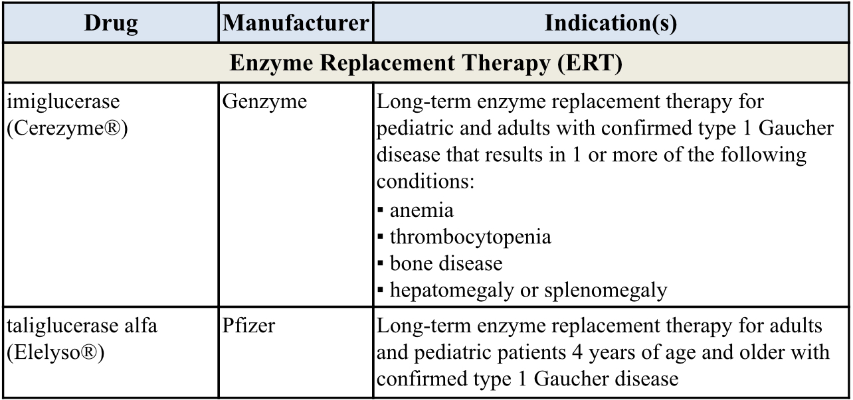
Gaucher Disease
PRODUCT LIST AND FDA-APPROVED INDICATIONS

Slide 70
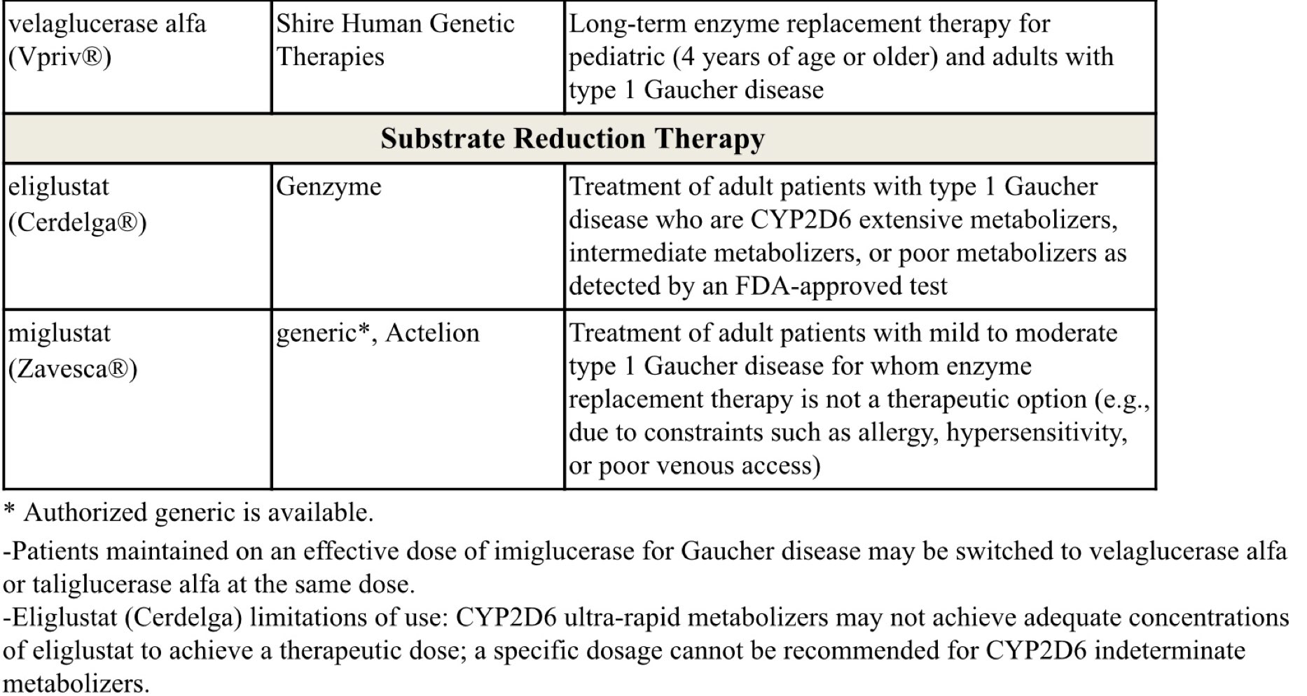
Gaucher Disease

Slide 71
Gaucher Disease
Gaucher disease (GD) is an autosomal recessive condition caused by deficiency of glucocerebrosidase
This deficiency results in abnormal accumulation of glycolipids in cell lysosomes, which can lead to skeletal disease , anemia, hemorrhage, thrombocytopenia, splenomegaly, hepatomegaly, and growth retardation
All IV enzyme replacement therapy (ERT) agents, imiglucerase (Cerezyme), velaglucerase alfa (Vpriv), and taliglucerase alfa (Elelyso) are forms of the enzyme glucocerebrosidase, whereas oral substrate reduction therapy (SRT) agents, eliglustat (Cerdelga) and miglustat (Zavesca), function as competitive and reversible inhibitors of the enzyme glucosylceramide synthase
Treatment should be individualized as response may vary

Slide 72
Gaucher Disease
The International Collaborative Gaucher Group (ICGG) Gaucher Registry guidelines developed from a consensus of international experts recommend ERT for symptomatic pediatric patients and for those with severe disease
Treatment is life-long, and therapy interruptions are not recommended
Anaphylaxis has been reported in patients treated with taliglucerase
The use of miglustat has been limited due to toxicity
In a systematic review, eliglustat and imiglucerase showed that both were effective for the treatment of type 1 GD

Slide 73
Erythropoiesis Stimulating Proteins

Slide 74
Erythropoiesis Stimulating Proteins
Drug | Manufacturer | FDA-Approved Indications
darbepoetin (Aranesp®) | Amgen | Treatment of anemia associated with chronic kidney disease (CKD) including patients on dialysis and patients not on dialysis Treatment of anemia in patients with non-myeloid malignancies where anemia is due to the effect of concomitant myelosuppressive chemotherapy and, upon initiation, a minimum of 2 additional months chemotherapy is planned Darbepoetin is not indicated for patients receiving myelosuppressive therapy when the anticipated outcome is cure or in in whom anemia can be managed by transfusion Darbepoetin is not indicated for use in patients receiving hormonal agents, therapeutic biologic products, or radiotherapy unless receiving concomitant myelosuppressive chemotherapy Darbepoetin is not indicated as a substitute for red blood cell (RBC) transfusion in patients who require immediate correction of anemia Darbepoetin use has not been demonstrated in controlled clinical trials to improve quality of life, fatigue, or patient well-being
luspatercept-aamt (Reblozyl®) | Celgene | Treatment of anemia in adult patients with beta thalassemia who require regular red blood cell (RBC) transfusions Treatment of anemia failing an erythropoiesis stimulating agent and requiring ≥ 2 RBC units over 8 weeks in adult patients with very low- to intermediate-risk myelodysplastic syndromes with ring sideroblasts (MDS-RS) or with myelodysplastic/myeloproliferative neoplasm with ring sideroblasts and thrombocytosis (MDS/MPN-RS-T) Luspatercept-aamt is not indicated for use as a substitute for RBC transfusions in patients who require immediate correction of anemia
PEG-EPO (Mircera®) | Roche/Vifor | Treatment of anemia associated with chronic renal failure (CRF) in adult patients on dialysis and adult patients not on dialysis Treatment of anemia associated with CRF in pediatric patients 5 to 17 years of age on hemodialysis who are converting from another ESA after their hemoglobin level was stabilized with an erythropoiesis stimulating agent (ESA) PEG-EPO use has not been demonstrated in controlled clinical trials to improve quality of life, fatigue, or patient well-being PEG-EPO is not indicated for treatment of anemia in patients receiving cancer chemotherapy PEG-EPO is not indicated as a substitute for red blood cell (RBC) transfusion in patients who require immediate correction of anemia

Slide 75
Erythropoiesis Stimulating Proteins
Drug | Manufacturer | FDA-approved Indications
rHuEPO (Epogen®) | Amgen | Treatment of anemia associated with CRF including patients on dialysis and patients not on dialysis to decrease the need for red blood cell (RBC) transfusion Treatment of anemia related to therapy with zidovudine (≤ 4,200 mg per week) in HIV-infected patients with endogenous serum erythropoietin levels of ≤ 500 mUnits/mL Treatment of anemia in patients with non-myeloid malignancies where anemia is due to the effect of concomitant myelosuppressive chemotherapy and, upon initiation, hemoglobin < 10 g/dL and there is a minimum of 2 additional months of planned chemotherapy Indicated to reduce the need for allogenic RBC transfusion among patients with perioperative hemoglobin > 10 to ≤ 13 g/dL who are at high risk for perioperative blood loss from elective, noncardiac, nonvascular surgery rHuEPO is not indicated for use in patients receiving hormonal agents, therapeutic biologic products, or radiotherapy unless receiving concomitant myelosuppressive chemotherapy rHuEPO is not indicated for patients receiving myelosuppressive therapy when the anticipated outcome is cure or in in whom anemia can be managed by transfusion rHuEPO is not indicated as a substitute for red blood cell (RBC) transfusion in patients who require immediate correction of anemia rHuEPO is not indicated in patients undergoing cardiac or vascular surgery ruEPO is not indicated for patients who are willing to donate autologous blood pre-operatively rHuEPO use has not been demonstrated in controlled clinical trials to improve quality of life, fatigue, or patient well-being
rHuEPO (Procrit®) | Amgen (distributed by Janssen)

Slide 76
Erythropoiesis Stimulating Proteins
Drug | Manufacturer | FDA-approved Indications
rHuEPO-epbx* (Retacrit®) | Pfizer (Hospira) | Treatment of anemia associated with CKD including patients on dialysis and patients not on dialysis to decrease the need for red blood cell (RBC) transfusion Treatment of anemia due to zidovudine administered at ≤ 4,200 mg per week in HIV-infected patients with endogenous serum erythropoietin levels of ≤ 500 mUnits/mL Treatment of anemia in patients with non-myeloid malignancies where anemia is due to the effect of concomitant myelosuppressive chemotherapy and, upon initiation, there is a minimum of 2 additional months of planned chemotherapy Reduce the need for allogeneic RBC transfusions among patients with perioperative hemoglobin > 10 to ≤ 13 g/dL who are at high risk for perioperative blood loss from elective, noncardiac, nonvascular surgery Epoetin alfa-epbx is not indicated for use in patients receiving hormonal agents, therapeutic biologic products, or radiotherapy unless receiving concomitant myelosuppressive chemotherapy Epoetin alfa-epbx is not indicated for patients receiving myelosuppressive therapy when the anticipated outcome is cure or in in whom anemia can be managed by transfusion Epoetin alfa-epbx is not indicated as a substitute for RBC transfusion in patients who require immediate correction of anemia Epoetin alfa-epbx is not indicated in patients undergoing cardiac or vascular surgery Epoetin alfa-epbx is not indicated for patients who are willing to donate autologous blood pre-operatively Epoetin alfa-epbx use has not been demonstrated in controlled clinical trials to improve quality of life, fatigue, or patient well-being

Slide 77
Erythropoiesis Stimulating Proteins
Anemia affects over 3 million Americans as it is a result of numerous diseases, as well as adverse effects of treatments
Erythropoietin is a glycoprotein produced in the kidneys that stimulates red blood cell production from bone marrow
The National Comprehensive Cancer Network (NCCN) guidelines state that erythropoiesis stimulating agents (ESAs) are associated with an increased risk of thrombosis, decreased survival, and shortened time to tumor; therefore, it is advised to use the lowest ESA dose possible to maintain hemoglobin (Hb) levels sufficient to avoid blood transfusions
The updated American Society of Clinical Oncology (ASCO) and the American Society of Hematology (ASH) joint clinical practice guidelines for the use of ESAs in patients with cancer also recommend minimizing ESA use, particularly in patients with malignancy being treated with curative intent

Slide 78
Erythropoiesis Stimulating Proteins
ESAs may be offered to patients with chemotherapy-associated anemia whose cancer treatment is not curative in intent and whose hemoglobin level is < 10 g/dL
This joint guideline recommends against the use of ESAs for the treatment of anemia associated with malignancy in patients who are not receiving concurrent myelosuppressive chemotherapy, except for patients with lower risk of myelodysplastic syndrome to avoid transfusions
Therapy with Epogen/Procrit, Mircera, and Aranesp for CKD should not exceed target hemoglobin of greater than 11 g/dL
The ASCO and ASH Update Committee maintains that all ESAs are equivalent with respect to effectiveness and safety
The international Kidney Disease: Improving Global Outcomes (KDIGO) group 2012 guidelines state that each ESA is effective in achieving and maintaining target Hb levels

Slide 79
Erythropoiesis Stimulating Proteins
Patients with endogenous serum erythropoietin levels ≤ 500 mUnits/mL, and who are receiving a dose of zidovudine ≤ 4,200 mg/week, may respond to rHuEPO therapy
Patients with endogenous serum erythropoietin levels > 500 mUnits/mL do not appear to respond to rHuEPO therapy
In 2011, the FDA published a safety communication regarding a more conservative dosing approach to ESAs in patients with CKD due to increased risks of cardiovascular (CV) events
Retacrit is the first FDA-approved biosimilar to Epogen/Procrit; Retacrit is neither considered interchangeable with nor does it carry the same indications as the reference products
Luspatercept-aamt (Reblozyl) is the first FDA-approved erythroid maturation agent, which reduces patient transfusion burden by regulating late-stage RBC maturation
It is approved for the treatment of anemia in adult patients with beta thalassemia who require regular red blood cell transfusions

Slide 80
Hypoglycemics, Alpha-Glucosidase Inhibitors

Slide 81
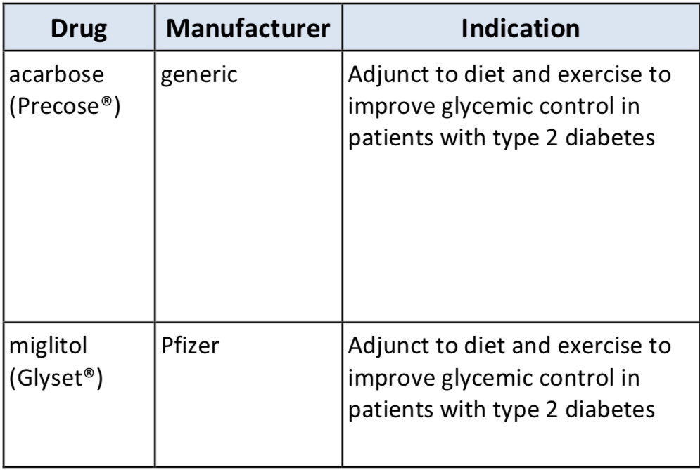
Hypoglycemics, Alpha-Glucosidase Inhibitors
PRODUCT LIST AND FDA-APPROVED INDICATIONS

Slide 82
Hypoglycemics, Alpha-Glucosidase Inhibitors
Miglitol is more potent than acarbose on a milligram-to-milligram basis
Alpha glucosidase inhibitors only have a modest effect on lowering HbA1c by about 0.4 to 0.7 percent
Alpha glucosidase inhibitors are relatively safe but GI side effects (e.g., bloating, flatulence, diarrhea) limit their use

Slide 83
Hypoglycemics, Incretin Mimetics/Enhancers

Slide 84
Hypoglycemics, Incretin Mimetics/Enhancers
Drug | Manufacturer | Indications
Amylin Analogue
pramlintide (Symlin®) | AstraZeneca | Adjunct therapy in type 1 and type 2 diabetes patients who use mealtime insulin therapy and have failed to achieve desired glucose control despite optimal insulin therapy (with or without concurrent sulfonylurea and/or metformin in type 2 patients)
Dipeptidyl Peptidase-4 (DPP-4) Enzyme Inhibitors
alogliptin (Nesina®) | Takeda, Perrigo* | Adjunct to diet and exercise to improve glycemic control in adults with type 2 diabetes mellitus (T2DM)
alogliptin/metformin (Kazano®) | Takeda, Perrigo*
alogliptin/pioglitazone (Oseni®) | Takeda, Perrigo*
linagliptin (Tradjenta®) | Boehringer Ingelheim | Adjunct to diet and exercise to improve glycemic control in adults with T2DM
linagliptin/empagliflozin (Glyxambi®) linagliptin/empagliflozin/metformin ER (Trijardy® XR) | Boehringer Ingelheim | Adjunct to diet and exercise to improve glycemic control in adults with T2DM Empagliflozin is indicated to reduce the risk of cardiovascular death in adults with T2DM and established cardiovascular disease (CVD)

Slide 85
Hypoglycemics, Incretin Mimetics/Enhancers
linagliptin/metformin (Jentadueto®) | Boehringer Ingelheim | Adjunct to diet and exercise to improve glycemic control in adults with T2DM when treatment with both linagliptin and metformin is appropriate
linagliptin/metformin ER (Jentadueto® XR)
saxagliptin (Onglyza®) | AstraZeneca | Adjunct to diet and exercise to improve glycemic control in adults with T2DM
saxagliptin/dapagliflozin (Qtern®)
saxagliptin/metformin ER (Kombiglyze® XR) | AstraZeneca | Adjunct to diet and exercise to improve glycemic control in adults with T2DM when treatment with both saxagliptin and metformin is appropriate
sitagliptin (Januvia®) | Merck Sharp & Dohme | Adjunct to diet and exercise to improve glycemic control in adults with T2DM
sitagliptin/ertugliflozin (Steglujan™) | Merck Sharp & Dohme | Adjunct to diet and exercise to improve glycemic control in adults with T2DM when treatment with both ertugliflozin and sitagliptin is appropriate
sitagliptin/metformin (Janumet®) | Merck Sharp & Dohme | Adjunct to diet and exercise to improve glycemic control in adults with T2DM when treatment with sitagliptin and metformin is appropriate
sitagliptin/metformin ER (Janumet XR®) | Merck Sharp & Dohme | Adjunct to diet and exercise to improve glycemic control in adults with T2DM when treatment with both sitagliptin and metformin ER is appropriate

Slide 86
Hypoglycemics, Incretin Mimetics/Enhancers
Drug | Manufacturer | Indications
Glucagon-like Peptide-1 Receptor Agonists (GLP-1RA)
dulaglutide (Trulicity®) | Eli Lilly | Adjunct to diet and exercise to improve glycemic control in adults with T2DM Reduce the risk of major adverse cardiovascular events (MACE) in adults with T2DM who have established CVD or multiple cardiovascular risk factors
exenatide (Byetta®) | AstraZeneca | Adjunct to diet and exercise to improve glycemic control in adults with T2DM who are taking metformin, a sulfonylurea, thiazolidinedione (TZD), or a combination of metformin and a sulfonylurea or TZD but have not achieved adequate glycemic control Add-on therapy to insulin glargine, with or without metformin and/or a TZD, in conjunction with diet and exercise for adults with T2DM who are not achieving adequate glycemic control on insulin glargine alone
exenatide ER (Bydureon®, Bydureon BCise®) | AstraZeneca | Adjunct to diet and exercise to improve glycemic control in adults with T2DM

Slide 87
Hypoglycemics, Incretin Mimetics/Enhancers
liraglutide (Victoza®) | Novo Nordisk | Adjunct to diet and exercise to improve glycemic control in adult and pediatric patients ≥ 10 years of age with T2DM Reduce the risk of major adverse cardiovascular events (MACE) in adults with T2DM and established cardiovascular disease (CVD)
liraglutide/insulin degludec (Xultophy®) | Novo Nordisk | Adjunct to diet and exercise to improve glycemic control in adults with T2DM
lixisenatide (Adlyxin®) | Sanofi-Aventis | Adjunct to diet and exercise to improve glycemic control in adults with T2DM
lixisenatide/insulin glargine (Soliqua®) | Sanofi-Aventis | Adjunct to diet and exercise to improve glycemic control in adults with type T2DM
semaglutide (Ozempic®) | Novo Nordisk | Adjunct to diet and exercise to improve glycemic control in adults with T2DM To reduce the risk of MACE (cardiovascular death, non-fatal myocardial infarction, non-fatal stroke) in adults with T2DM and established CVD
semaglutide (Rybelsus®) | Novo Nordisk | Adjunct to diet and exercise to improve glycemic control in adults with T2DM

Slide 88
Hypoglycemics, Incretin Mimetics/Enhancers
It is estimated that over 34 million people in the US have diabetes; type 2 diabetes (T2DM) accounts for about 90% to 95% of all diagnosed cases of diabetes in adults
Per the latest American Diabetes Association (ADA), American Association of Clinical Endocrinologists (AACE)/American College of Endocrinology (ACE), American College of Physicians (ACP), and meta-analyses, metformin is recommended as first line therapy for the treatment of T2DM, along with lifestyle interventions, unless metformin is contraindicated
Per the 2020 ADA Standards of Medical Care in Diabetes, if metformin fails to produce the target HbA1c after 3 months of therapy, a thiazolidinedione (TZD), sulfonylurea (SU), dipeptidyl peptidase-4 (DPP-4) inhibitor, SGLT2 inhibitor, glucagon-like peptide-1 (GLP-1) receptor agonist, or basal insulin should be added in patients without atherosclerotic cardiovascular disease (ASCVD) or CKD

Slide 89
Hypoglycemics, Incretin Mimetics/Enhancers
In patients with ASCVD or CKD, the addition of an agent with known CV or renal benefit (select GLP-1 agonist or select SLGT2 inhibitor) is preferred
The selection of medications should be patient-centric and prescribers should consider potential issues such as HbA1c target, impact on weight and hypoglycemia, side effects, the frequency and mode of administration, patient adherence, patient preference, and cost
TZDs and SUs are generally considered less safe than GLP-1 receptor agonists, SGLT2 inhibitors, DPP-4 inhibitors, or alpha-glucosidase inhibitors
Per the 2020 AACE/ACE guidelines, agents for monotherapy are recommended in the following order (highest to lowest recommendation): metformin, GLP-1 receptor agonists, SGLT2 inhibitors, DPP-4 inhibitors, or alpha-glucosidase inhibitor
AACE/ACE indicates that Victoza, Jardiance, and Qtern may offer renal and CV benefit. They also suggest that Onglyza and Nesina may be associated with possible CV risk; there may be increased risk of bone fractures with Invokana; and increased congestive heart failure (HF) risk with sulfonylureas, glinides, and insulin

Slide 90
Hypoglycemics, Incretin Mimetics/Enhancers
In 2017, the ACP updated their recommendations for T2DM and advised that metformin can be safely used in patients with mild renal impairment and in select patients with moderate impairment
The ACP’s revised guidelines for T2DM suggest a sulfonylurea, TZD, SGLT-2 inhibitor, or a DPP-4 inhibitor as preferred second-line treatments
The 2018 World Health Organization (WHO) guidelines for treatment intensification in patients with T2DM recommend addition of a DPP-4 inhibitor, a SGLT2 inhibitor, or a TZD if insulin is unsuitable in patients with T2DM who do not achieve glycemic control with metformin and/or a sulfonylurea
Amylin Analogues slow gastric emptying, suppress glucagon secretion, and centrally modulate appetite. They may also be used for type 1 diabetes

Slide 91
Hypoglycemics, Incretin Mimetics/Enhancers
DPP-4 Enzyme Inhibitors increase insulin secretion and reduce glucagon secretion by preventing inactivation of GLP-1
GLP-1 Receptor Agonists enhance glucose-dependent insulin secretion, suppress elevated glucagon secretion, and slow gastric emptying
HbA1c improvements for Amylin Analogues average 0.3% to 0.6% with a potential weight reduction of 0.5 kg to 1.5 kg
HbA1c improvements for DPP-4s average 0.5% to 1%. These agents are weight-neutral and have a low hypoglycemia risk when used as monotherapy or in conjunction with metformin
For GLP-1 receptor agonists, Tanzeum averages HbA1c reductions of 0.7% to 0.9%; Trulicity averages 0.7% to 1.6%; Byetta/Bydureon and Victoza average reductions in HbA1c of 0.5% to 1.6%; Adlyxin reductions average 0.3% to 0.65%; and Ozempic reductions of 1.4% to 1.5%

Slide 92
Hypoglycemics, Incretin Mimetics/Enhancers
Product/Guideline Updates:
In 2020 the ACC published an expert consensus decision pathway for CV risk reduction in patients with T2DM
An SGLT2 inhibitor or a GLP-1RA may be initiated in any patient with T2DM and ASCVD at the time of diagnosis of T2DM or ASCVD or any time after diagnosis
An agent from either class can also be started in patients with T2DM without established ASCVD but who are at high risk of ASCVD
In addition, initiation of an SGLT2 inhibitor with demonstrated CV or renal benefit is recommended in patients with HF and/or diabetic kidney disease
A GLP-1RA is an alternative in patients with eGFR < 30 ml/min/1.73 m²

Slide 93
Hypoglycemics, Incretin Mimetics/Enhancers
Product/Guideline Updates:
The cardiovascular outcomes study discussion was revised
SGLT2 inhibitors and GLP-1 agonists are recommended for patients with ASCVD, heart failure, or CKD, independent of HbA1c
The FDA issued communication stating that sitagliptin-containing products have not been proven to improve glycemic control in pts 10 to 17 y/o with T2DM
This is based on results of 3 clinical trials that did not demonstrate an improvement in HbA1c; labeling has been updated accordingly

Slide 94
Hypoglycemics, Incretin Mimetics/Enhancers
Product/Guideline Updates:
The ADA and the European Association for the Study of Diabetes (EASD) updated their 2015 position statement on the management of T2DM
In appropriate high-risk individuals with T2DM, the decision to treat with a GLP-1RA or SGLT2 inhibitor to reduce MACE, hospitalization for HF, CV death, or CKD progression should be considered independently of baseline HbA1c or individualized HbA1c target
For patients with T2DM and established ASCVD, GLP-1RAs demonstrate the highest level of benefit
To reduce risk of MACE, GLP-1RAs can also be considered in patients with T2DM at high risk for ASCVD, particularly those ≥ 55 years of age with coronary, carotid or lower extremity artery stenosis > 50%, left ventricular hypertrophy, eGFR < 60 mL/min/1.73 m², or albuminuria
For patients with HFrEF (EF < 45%) or CKD (eGFR 30 to ≤ 60 mL/min/1.73 m² or UACR > 30 mg/g, particularly UACR >300 mg/g), SGLT2 inhibitors are associated with the highest level of benefit
SGLT2 inhibitors are recommended to prevent the progression of CKD, hHF, MACE and CV death in patients with T2DM with CKD

Slide 95
Hypoglycemics, Metformins

Slide 96
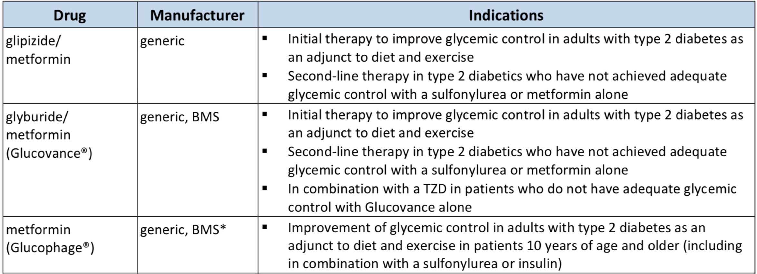
Hypoglycemics, Metformins
PRODUCT LIST AND FDA-APPROVED INDICATIONS

Slide 97
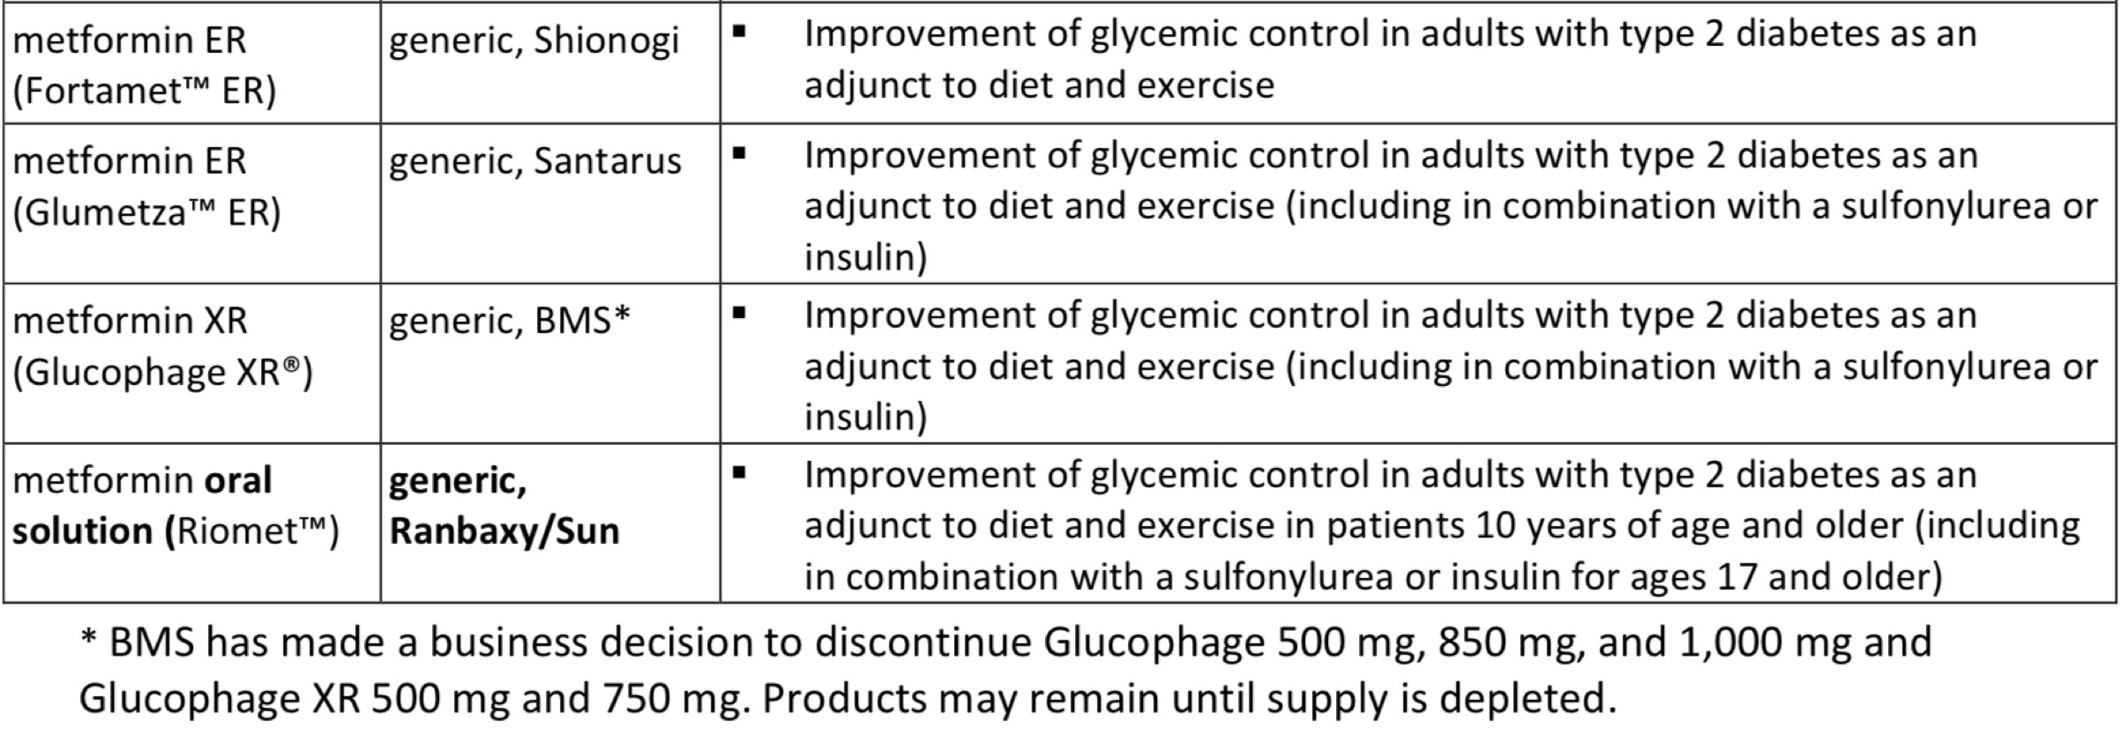
Hypoglycemics, Metformins

Slide 98
Hypoglycemics, Metformins
Findings from meta-analyses support metformin as first-line therapy, citing relative safety and beneficial effects on HbA1c, weight, and cardiovascular mortality
Per the 2020 American Diabetes Association (ADA) Standards of Medical Care in Diabetes, metformin is recommended as initial therapy for the treatment of T2DM, along with lifestyle interventions at the time of diagnosis, unless metformin is contraindicated
The American Association of Clinical Endocrinologists (AACE) and American College of Endocrinology (ACE) 2019 diabetes management algorithm and 2015 clinical practice guidelines for developing a diabetes care plan also recommend metformin as first-line therapy

Slide 99
Hypoglycemics, Metformins
The AACE/ACE guidelines lists metformin as the highest recommended agent among all anti-hyperglycemic medications for monotherapy
The American College of Physicians’ (ACP) revised 2017 guidelines for T2DM recommend metformin as first-line therapy
Metformin-containing products should not be used in patients with:
  renal disease or severe renal dysfunction (estimated glomerular filtration rate
  [eGFR] below 30 mL/minute/1.73 m2)
  acute or chronic metabolic acidosis including diabetic ketoacidosis
  conditions that can lead to renal dysfunction, including acute myocardial infarction and septicemia

Slide 100
Hypoglycemics, SGLT2

Slide 101
Hypoglycemics, SGLT2
Drug | Manufacturer | Indications
canagliflozin (Invokana®) | Janssen | Adjunct to diet and exercise to improve glycemic control in adults with type 2 diabetes mellitus (T2DM) To reduce the risk of major adverse cardiovascular events (MACE) in adults with T2DM and established cardiovascular disease (CVD) To reduce the risk of end-stage kidney disease, doubling of serum creatinine, cardiovascular (CV) death, and hospitalization for heart failure in adults T2DM and diabetic nephropathy with albuminuria > 300 mg/day
canagliflozin/ metformin (Invokamet®) | Janssen | Adjunct to diet and exercise to improve glycemic control in adults with T2DM To reduce the risk of MACE in adults with T2DM and established CVD Canagliflozin is indicated to reduce the risk of MACE in adults with T2DM and established CVD Canagliflozin is indicated to reduce the risk of end-stage kidney disease, doubling of serum creatinine, CV death, and hospitalization for heart failure in adults with T2DM and diabetic nephropathy with albuminuria
canagliflozin/ metformin ER (Invokamet® XR) | Janssen
dapagliflozin (Farxiga®) | AstraZeneca | Adjunct to diet and exercise to improve glycemic control in adults with T2DM To reduce the risk of hospitalization for heart failure in adults with T2DM and established CVD or multiple CV risk factors To reduce the risk of CV death and hospitalization for heart failure (HF) in adults with HF (NYHA class II-IV) with reduced ejection fraction

Slide 102
Hypoglycemics, SGLT2
dapagliflozin/ metformin ER (Xigduo® XR) | AstraZeneca | Adjunct to diet and exercise to improve glycemic control in adults with T2DM Dapagliflozin is indicated to reduce the risk of hospitalization for heart failure in adults with T2DM and established CVD or multiple CV risk factors.
empagliflozin (Jardiance®) | Boehringer Ingelheim | Adjunct to diet and exercise to improve glycemic control in adults with T2DM To reduce the risk of cardiovascular death in adults with T2DM and established CVD
empagliflozin/ metformin (Synjardy®) | Boehringer Ingelheim | Adjunct to diet and exercise to improve glycemic control in adults with T2DM when treatment with both empagliflozin and metformin is appropriate Empagliflozin is indicated to reduce the risk of cardiovascular death in adults with T2DM and established CVD*
empagliflozin/ metformin ER (Synjardy® XR) | Boehringer Ingelheim
ertugliflozin (Steglatro™) | Merck, Sharp & Dohme | Adjunct to diet and exercise to improve glycemic control in adults T2DM
ertugliflozin/ metformin (Segluromet™) | Merck, Sharp & Dohme | Adjunct to diet and exercise to improve glycemic control in adults with T2DM who are not adequately controlled on a regimen containing ertugliflozin or metformin, or in patients who are already treated with both ertugliflozin and metformin

Slide 103
Hypoglycemics, SGLT2
Studies evaluating the impact of SGLT2 inhibitors on macrovascular complications, (e.g., cardiovascular outcomes) include the EMPA-REG OUTCOME and CANVAS/CANVAS-R
The EMPA-REG OUTCOME trial reported approximately a one-third relative risk reduction for cardiovascular death, hospitalization due to heart failure, and all-cause death with use of empagliflozin (Jardiance) as compared to placebo
CANVAS and CANVAS-R trials demonstrated a 14% risk reduction (hazard ratio [HR], 0.86 [95% CI, 0.75 to 0.97]) in first occurrence of major adverse cardiovascular event (MACE) in patients with T2DM treated with canagliflozin (Invokana)
Based on the DECLARE–TIMI 58 trial, dapagliflozin did not result in a lower rate of MACE compared to placebo; however, it did lead to reduced all-cause mortality and the composite of CV death, as well as a lower incidence of HF-related hospitalizations

Slide 104
Hypoglycemics, SGLT2
The SGLT2 inhibitors are efficacious agents in reducing HbA1c, postprandial glucose, and fasting plasma glucose, as well as reducing systolic blood pressure and weight
The long-term safety of SGLT2 inhibitors remains to be established
If there is a compelling need to minimize weight gain or promote weight loss, a GLP-1 agonist or SGLT2 inhibitor are recommended
The ADA prefers medications with proven CV and renal benefit in patients with CV and/or renal disease, respectively
In patients with ASCVD, the addition of empagliflozin (Class A recommendation), liraglutide (Class A recommendation), or canagliflozin (Class C recommendation) is preferred
In patients with heart failure (HF) or chronic kidney disease (CKD), empagliflozin, canagliflozin, or dapagliflozin is preferred

Slide 105
Hypoglycemics, SGLT2
The American Association of Clinical Endocrinologists (AACE) and American College of Endocrinology (ACE) 2020 diabetes management algorithm and 2015 clinical practice guidelines for developing a diabetes care plan include the use of SGLT2 inhibitors as an alternative to metformin for monotherapy and as an appropriate add-on to metformin in dual therapy and triple therapy
AACE/ACE recognizes that empagliflozin and canagliflozin are associated with significantly reduced cardiac mortality, hospitalization for heart failure, as well as secondary renal endpoints
Additionally, dapagliflozin demonstrated reduced all-cause mortality and the composite of CV death and HF hospitalization; however, it did not significantly lower the combined risk of CV death and nonfatal MI and stroke
In the 2020 algorithm, the panel identifies SGLT2 inhibitors as having a neutral effect on bone

Slide 106
Hypoglycemics, SGLT2
In 2015, the Food and Drug Administration (FDA) issued a warning that use of SGLT2 inhibitors may lead to ketoacidosis
In August 2018, the FDA issued another safety communication regarding the risk of Fournier’s gangrene with the use of the SGLT2 inhibitors
As a result, the FDA is requiring a new warning to be added to the labeling of all SGLT2 inhibitors and SGLT2 inhibitor-containing medications regarding this risk
The FDA also recently alerted prescribers of an increased risk of bone fracture in patients treated with canagliflozin (Invokana, Invokamet, Invokamet XR)

Slide 107
Hypoglycemics, SGLT2
The Endocrine Society issued 2019 guideline recommendations for diabetes in patients aged ≥ 65 years
They recommend simplified outpatient medication regimens and glycemic targets tailored to improve compliance and prevent complications, such as hypoglycemia and falls, particularly in patients with cognitive impairment
When pharmacological therapy is indicated, metformin, in addition to lifestyle management, is recommended first-line
If glycemic targets are not attained with metformin and lifestyle management, oral and injectable therapies with low risk for hypoglycemia are suggested
The guidelines also have recommendations for management of common comorbidities in this population including hypertension, hyperlipidemia, congestive heart failure, retinopathy, neuropathy, and chronic kidney disease

Slide 108
Hypoglycemics, SGLT2
Product/Guideline Updates:
The FDA issued a Drug Safety Communication to update an earlier communication regarding the risk of leg and foot amputations with canagliflozin-containing medications
The update states that, based on review of data from 3 new clinical trials, they have removed the Boxed Warning language from package inserts of canagliflozin-containing medications
The FDA states that subsequent data have demonstrated additional clinical benefits leading to additional indication approvals, while the risk of amputation (although still present) is lower than previously described; the risk of amputation remains a warning in the labeling
The updated ADA standards advise to interrupt SGLT2 inhibitor therapy before scheduled surgery to avoid diabetic ketoacidosis; this aligns with label revisions for SGLT2 inhibitors
For management of CVD in patients with T2DM, the ADA advises to consider an SGLT2 inhibitor in patients with HF with reduced ejection fraction to reduce risk of worsening HF and CV death

Slide 109
Hypoglycemics, SGLT2
Product/Guideline Updates:
The Kidney Disease: Improving Global Outcomes (KDIGO) organization published its first guidelines on managing diabetes in patients with CKD
In patients with diabetes and CKD, metformin and a SGLT2 inhibitor are recommended in patients with eGFR ≥ 30 mL/min/1.7 m2; if glycemic targets are not met, then a long-acting GLP-1 agonist is recommended
The Endocrine Society issued 2019 guideline recommendations for diabetes in patients aged ≥ 65 years
They recommend simplified outpatient medication regimens and glycemic targets tailored to improve compliance and prevent complications
When pharmacological therapy is indicated, metformin, in addition to lifestyle management, is recommended first-line

Slide 110
Hypoglycemics, SGLT2
Product/Guideline Updates:
If glycemic targets are not attained with this approach, oral and injectable therapies with low risk for hypoglycemia are suggested.
The guidelines also have recommendations for management of common comorbidities in this population including hypertension, hyperlipidemia, congestive heart failure, retinopathy, neuropathy, and chronic kidney disease.
SGLT2 inhibitors have been shown to reduce major adverse cardiovascular events (MACE), heart failure, and progression of CKD

Slide 111
Immune Globulins

Slide 112
Immune Globulins
Drug | Manufacturer | Indications
Intravenous
Asceniv™ | ADMA | Primary humoral immunodeficiency
Bivigam® | Biotest/ADMA | Primary humoral immunodeficiency
Flebogamma® DIF 5% and 10% | Grifols | Primary (inherited) immunodeficiency Chronic primary immune thrombocytopenia (10% only)
Gammagard® S/D | Baxalta | Primary humoral immunodeficiency Prevention of bacterial infections in hypogammaglobulinemia and/or recurrent bacterial infections associated with B-cell chronic lymphocytic leukemia Chronic idiopathic thrombocytopenic purpura Prevention of coronary artery aneurysms associated with Kawasaki syndrome
Gammaplex® 5% and 10% | Bio Products Laboratory | Primary humoral immunodeficiency Chronic immune thrombocytopenic purpura
Octagam® 5% and 10% | Octapharma | Primary humoral immunodeficiency (5% only) Chronic immune thrombocytopenic purpura (10% only)
Panzyga® | Octapharma/ Pfizer | Primary humoral immunodeficiency Chronic immune thrombocytopenia
Privigen® | CSL Behring | Primary humoral immunodeficiency Chronic immune thrombocytopenic purpura Chronic inflammatory demyelinating polyneuropathy (Limitation of use: maintenance therapy has not been studied > 6 months)

Slide 113
Immune Globulins
Intravenous or Subcutaneous
Gammagard® Liquid | Baxalta | Primary humoral immunodeficiency Multifocal motor neuropathy
Gammaked™ | Kedrion Biopharm† | Primary humoral immunodeficiency Idiopathic thrombocytopenic purpura (IV use only) Chronic inflammatory demyelinating polyneuropathy (IV use only)
Gamunex®-C | Grifols Therapeutics | Primary humoral immunodeficiency Idiopathic thrombocytopenic purpura (IV use only) Chronic inflammatory demyelinating polyneuropathy (IV use only)

Slide 114
Immune Globulins
Subcutaneous
Cutaquig® | Octapharma/ Pfizer | Primary humoral immunodeficiency
Cuvitru™ | Shire/Takeda | Primary humoral immunodeficiency
Hizentra® | CSL Behring | Primary immune deficiency Maintenance therapy in patients with chronic inflammatory demyelinating polyneuropathy
immune globulin 10%/recombinant human hyaluronidase (Hyqvia®) | Baxalta | Primary immune deficiency†
Xembify® | Grifols | Primary humoral immunodeficiency

Slide 115
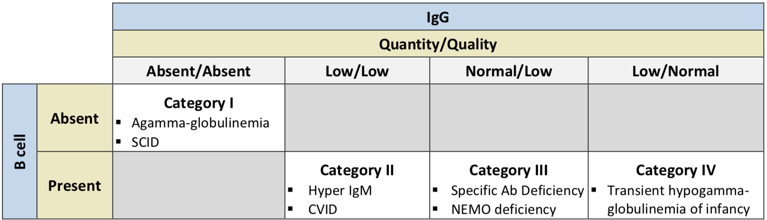
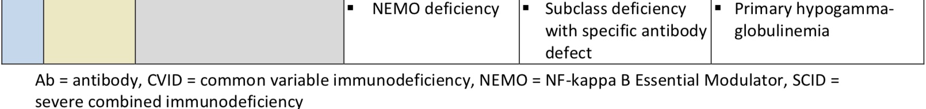
Immune Globulins

Slide 116
Immune Globulins
Exogenous immune globulin product has also been FDA approved for use in multifocal motor neuropathy (MMN), chronic inflammatory demyelinating polyneuropathy (CIDP), idioathic thrombocytopenic purpura (ITP), Kawasaki disease, and B-cell chronic lymphocytic leukemia
Therapeutic immune globulin is prepared from pooled plasma obtained from healthy donors at plasma donation centers in the US
These products are purified to contain 95% to 99% IgG with trace amounts of IgA and IgM
Each product has validated their production methods to ensure low risk of transmission of viruses
Preparation for each product differs in purification, including production methods related to fractionation, exchange chromatography, and filtration

Slide 117
Immune Globulins
The AAAAI and the Clinical Immunology Society both recommend product selection to be relied heavily on patient-specific characteristics
The subcutaneous route is as efficacious as the intravenous route for the treatment of primary immunodeficiencies
All the products in the class have similar efficacy and safety profiles
Due to limited supply, the use of immune globulin products should be reserved for approved indications or conditions where the benefit has been clearly established and is consistent with clinical guidelines

Slide 118
Oncology Oral,
Hematologic Cancers

Slide 119
Oncology Oral, Hematologic Cancers
Drug | Manufacturer | FDA-Approved Indications
acalabrutinib (Calquence®) | AstraZeneca | Treatment of adults with mantle cell lymphoma (MCL) treated with ≥ 1 prior therapy Treatment of adult patients with chronic lymphocytic leukemia (CLL) or small lymphocytic lymphoma (SLL)
bosutinib (Bosulif®) | Pfizer | Newly diagnosed chronic phase (CP) Ph+ CML Treatment of chronic, accelerated, or blast phase Ph+ chronic myeloid leukemia (CML) with resistance or intolerance to prior therapy
busulfan (Myleran®) | Aspen/ Prasco LA | Palliative treatment of chronic myelogenous (myeloid, myelocytic, granulocytic) leukemia†
chlorambucil (Leukeran®) | Aspen/ Prasco LA | Treatment of chronic lymphatic (lymphocytic) leukemia, malignant lymphomas, including lymphosarcoma, giant follicular lymphoma, and Hodgkin’s disease; chlorambucil is not curative in any of these disorders but may produce clinically useful palliation
dasatinib (Sprycel®) | Bristol-Meyers Squibb | Treatment of adults with chronic, accelerated, or myeloid or lymphoid blast phase Ph+ CML with resistance or intolerance to prior therapy including imatinib (Gleevec) Treatment of adults with Ph+ acute lymphoblastic leukemia (ALL) with resistance or intolerance to prior therapy Newly diagnosed adult patients with Ph+ CML in chronic phase Treatment of pediatric patients with Ph+ CML in chronic phase Treatment of pediatric patients with newly diagnosed Ph+ ALL in combination with chemotherapy
^{[i]} Calquence [package insert]. Wilmington, DE. AstraZeneca; November 2017.
^{[ii]} Bosulif [package insert]. New York, NY. Pfizer; October 2018.^{i]} Myleran [package insert] Mason, OH. Aspen Global; September 2017.
^{[iv]} Leukera [package insert] Mason, OH. Aspen Global; November 2017.
[v] Sprycel [package insert]. Princeton, NJ; Bristol-Meyers Squibb; December 2018.

Slide 120
Oncology Oral, Hematologic Cancers
duvelisib (Copiktra®) | Verastem | Relapsed or refractory chronic lymphocytic leukemia (CLL) or small lymphocytic lymphoma (SLL) after ≥ 2 prior therapies Relapsed or refractory follicular lymphoma (FL) after ≥ 2 prior systemic therapies
enasidenib (Idhifa®) | Celgene | Relapsed or refractory acute myeloid leukemia (AML) with an isocitrate dehydrogenase-2 (IDH2) mutation, as determined with an FDA-approved test‡
fedratinib (Inrebic®) | Celgene | Intermediate-2 or high-risk primary or secondary post-polycythemia vera or post-essential thrombocythemia myelofibrosis (MF)
gilteritinib (Xospata®) | Astellas | Relapsed or refractory adults with AML with a FLT3 mutation, as detected by an FDA-approved test
glasdegib (Daurismo™) | Pfizer | In combination with low-dose cytarabine, for the treatment of newly diagnosed AML in adult patients who are ≥ 75 years old or who have comorbidities that preclude use of intensive induction chemotherapy

Slide 121
Oncology Oral, Hematologic Cancers
hydroxyurea (Hydrea®) | generic, Bristol-Myers Squibb | Resistant CML Locally advanced squamous cell carcinomas of the head and neck (excluding lip), in combination with concurrent chemoradiation‖
ibrutinib (Imbruvica®) | Pharmacyclics | Mantle cell lymphoma (MCL) in patients who have received ≥ 1 prior therapy* CLL/ SLL CLL/ SLL with 17p deletion Waldenström’s macroglobulinemia Marginal zone lymphoma (MZL) requiring systemic therapy and patient has had prior anti-CD20-based therapy* Chronic graft versus host disease (cGVHD) after failure of ≥ 1 line of systemic therapy
idelalisib (Zydelig®) | Gilead | Relapsed chronic CLL in combination with rituximab in patients for whom rituximab alone would be considered appropriate therapy due to other comorbidities¶ Relapsed follicular B-cell non-Hodgkin’s lymphoma in patients who have received ≥ 2 prior systemic therapies*,¶ Relapsed SLL in patients who have received ≥ 2 prior systemic therapies*,¶

Slide 122
Oncology Oral, Hematologic Cancers
imatinib (Gleevec®) | generic, Novartis | Newly diagnosed adult and pediatric patients with Ph+ CML in chronic phase Patients with Ph+ CML in blast crisis, accelerated phase, or chronic phase after failure of interferon-alpha therapy Adult patients with relapsed or refractory Ph+ ALL Pediatric patients with newly diagnosed Ph+ ALL in combination with chemotherapy Adult patients with myelodysplastic/ myeloproliferative diseases associated with platelet-derived growth factor receptor (PDGFR) gene re-arrangements as determined with an FDA-approved test‡ Adult patients with aggressive systemic mastocytosis without the D816V c-Kit mutation, as determined with an FDA-approved test or with c-Kit mutational status unknown‡ Adult patients with hypereosinophilic syndrome and/or chronic eosinophilic leukemia who have the FIP1L1-PDGFRα fusion kinase (mutational analysis or FISH demonstration of CHIC2 allele deletion) and for patients with hypereosinophilic syndrome and/or chronic eosinophilic leukemia who are FIP1L1-PDGFRα fusion kinase-negative or unknown Adult patients with unresectable, recurrent, and/or metastatic dermatofibrosarcoma protuberans (DFSP) Patients with Kit (CD117)-positive unresectable and/or metastatic malignant gastrointestinal stromal tumors (GIST) Adjuvant treatment of adult patients following resection of Kit (CD117)-positive GIST

Slide 123
Oncology Oral, Hematologic Cancers
Drug | Manufacturer | FDA-Approved Indications
ivosidenib (Tibsovo®) | Agios | Adult patients with relapsed or refractory AML with a susceptible isocitrate dehydrogenase-1 (IDH1) mutation, as detected by an FDA-approved test‡ Adult patients with newly diagnosed AML who are ≥ 75 years old or who have comorbidities that preclude the use of intensive induction chemotherapy with a susceptible IDH1 mutation, as detected by an FDA-approved test
ixazomib (Ninlaro®) | Millennium | In combination with lenalidomide and dexamethasone for the treatment of multiple myeloma in patients who have received ≥ 1 prior therapy
lenalidomide (Revlimid®) | Celgene | In combination with dexamethasone for the treatment of multiple myeloma As maintenance therapy for multiple myeloma following autologous hematopoietic stem cell transplantation (auto-HSCT) Treatment of transfusion-dependent anemia due to low-or intermediate-1-risk myelodysplastic syndromes associated with a deletion of 5q cytogenetic abnormality with or without additional cytogenetic abnormalities Treatment of mantle cell lymphoma after relapse or disease progression after 2 prior therapies, 1 of which included bortezomib In combination with a rituximab product for the treatment of previously treated FL In combination with a rituximab product for the treatment of previously treated MZL

Slide 124
Oncology Oral, Hematologic Cancers
melphalan (Alkeran®) | generic, Apopharma | Palliative treatment of multiple myeloma Palliation of non-resectable epithelial carcinoma of the ovary
mercaptopurine (Purixan®), | generic (tablets); Nova (suspension) | ALL as a component of a combination maintenance therapy regimen
midostaurin (Rydapt®) | Novartis | Newly diagnosed AML that is FLT3 mutation-positive as detected by an FDA-approved test‡, in combination with standard cytarabine and daunorubicin induction and cytarabine consolidation** Aggressive systemic mastocytosis (ASM), systemic mastocytosis with associated hematological neoplasm (SM-AHN), or mast cell leukemia
nilotinib (Tasigna®) | Novartis | Accelerated phase and chronic phase Ph+ CML in adult patients resistant to or intolerant to prior therapy that included imatinib (Gleevec) Newly diagnosed adult and pediatric patients ≥ 1 year of age with Ph+ CML in chronic phase Treatment of chronic phase Ph+ CML with resistance or intolerance to prior tyrosine kinase inhibitor (TKI) therapy in pediatric patients ≥ 1 year of age
panobinostat (Farydak®) | Novartis/Secura | Treatment of multiple myeloma in combination with bortezomib and dexamethasone in patients who have received ≥ 2 prior regimens, including bortezomib and an immunomodulatory agent

Slide 125
Oncology Oral, Hematologic Cancers
Drug | Manufacturer | FDA-Approved Indications
pomalidomide (Pomalyst®) | Celgene | For use in combination with dexamethasone for patients with multiple myeloma who have received ≥ 2 prior therapies including lenalidomide and a proteasome inhibitor and have demonstrated disease progression on or within 60 days of completion of the last therapy For the treatment of adults with acquired immunodeficiency syndrome (AIDS)-related Kaposi sarcoma (KS) after failure of highly active antiretroviral therapy (HAART), as well as for the treatment of KS in adults who are human immunodeficiency virus (HIV)-negative
ponatinib (Iclusig®) | Ariad/Takeda, Millennium | Treatment of adult patients with T315I-positive chronic myeloid leukemia (CML) (chronic phase, accelerated phase, or blast phase) or T315I-positive Philadelphia chromosome positive acute lymphoblastic leukemia (Ph+ALL) Treatment of adult patients with chronic phase, accelerated phase, or blast phase chronic myeloid leukemia or Ph+ALL for whom no other TKI is indicated††
procarbazine (Matulane®) | Leadiant | For use in combination with other anticancer drugs for the treatment of stage 3 and stage 4 Hodgkin’s disease; used as part of the MOPP regimen (nitrogen mustard, vincristine, procarbazine, prednisone)
ruxolitinib (Jakafi®) | Incyte | Intermediate or high-risk MF, including primary MF, post-polycythemia vera MF and post-essential thrombocythemia MF Treatment of polycythemia vera in patients who have had an inadequate response to or are intolerant of hydroxyurea Treatment of steroid-refractory acute graft versus host disease (GVHD) in adult and pediatric patients ≥ 12 years of age
selinexor (Xpovio™) | Karyopharm | In combination with dexamethasone for the treatment of relapsed or refractory multiple myeloma (RRMM) who have received ≥ 4 prior therapies and whose disease is refractory to ≥ 2 proteasome inhibitors, ≥ 2 immunomodulatory agents, and an anti-CD38 monoclonal antibody Treatment of adults with relapsed or refractory diffuse large B-cell lymphoma (DLBCL), not otherwise specified, including DLBCL arising from follicular lymphoma, after ≥ 2 lines of systemic therapy

Slide 126
Oncology Oral, Hematologic Cancers
thalidomide (Thalomid®) | Celgene | Treatment of newly diagnosed multiple myeloma in combination with dexamethasone Acute treatment of cutaneous manifestations of moderate to severe erythema nodosum leprosum (ENL)‡‡ Prevention and suppression of cutaneous manifestations of ENL recurrence as maintenance therapy
thioguanine (Tabloid®) | Aspen/Prasco LA | For remission induction and remission consolidation of acute nonlymphocytic leukemias§
tretinoin | generic | For remission induction in patients with acute promyelocytic leukemia (APL), FAB classification M3 characterized by the presence of the t(15;17) translocation and/or presence of the PML/RARα gene who are refractory to, have relapsed from, or have a contraindication to anthracycline chemotherapy‖‖
venetoclax (Venclexta®) | AbbVie | Treatment of CLL or SLL in adult patients In combination with azacitidine, decitabine, or low-dose cytarabine for the treatment of newly diagnosed AML in adults who are age 75 years or older or who have comorbidities that preclude use of intensive induction chemotherapy*
vorinostat (Zolinza®) | Merck, Sharp & Dohme | Treatment of cutaneous manifestations of cutaneous T-cell lymphoma (CTCL) in patients who have progressive, persistent, or recurrent disease on or following 2 systemic therapies
zanubrutinib (Brukinsa™) | Beigene | Treatment of adult patients with mantle cell lymphoma (MCL) who have received ≥ 1 prior therapy*

Slide 127
Ophthalmics, Anti-Inflammatory/Immunomodulator

Slide 128
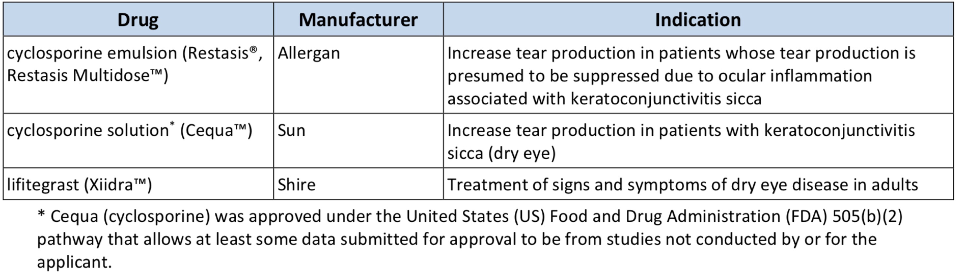
Ophthalmics, Anti-Inflammatory/Immunomodulator
PRODUCT LIST AND FDA-APPROVED INDICATIONS

Slide 129
Ophthalmics, Anti-Inflammatory/Immunomodulator
Dry eye disease (DES)/ Keratoconjunctivitis sicca (KCS) affects approximately 10% to 30% of the US population and occurs more commonly in patients over 40 years of age and in postmenopausal women
According to the 2018 Preferred Practice Parameter on dry eye syndrome and the 2019 Cornea/External Disease Summary Benchmark from the American Academy of Ophthalmology (AAO), artificial tear substitutes are recommended for mild DES
Recommended measures for moderate dry eyes include use of anti-inflammatory agents, such as topical cyclosporine (Cequa, Restasis, Restasis Multidose), lifitegrast (Xiidra), topical corticosteroids, or systemic omega-3 fatty acids supplements, along with artificial tears

Slide 130
Ophthalmics, Anti-Inflammatory/Immunomodulator
For severe dry eye, in addition to the above-mentioned treatments, systemic cholinergics, systemic anti-inflammatories, mucolytic agents, autologous serum tears, contact lenses, permanent punctal occlusion, and tarsorrhaphy are recommended
No clinical trials have been published comparing any of the 3 agents in this class, but all have demonstrated efficacy against vehicle
Significant adverse effects are similar between the 3 agents in this class

Slide 131
Otic Antibiotics

Slide 132
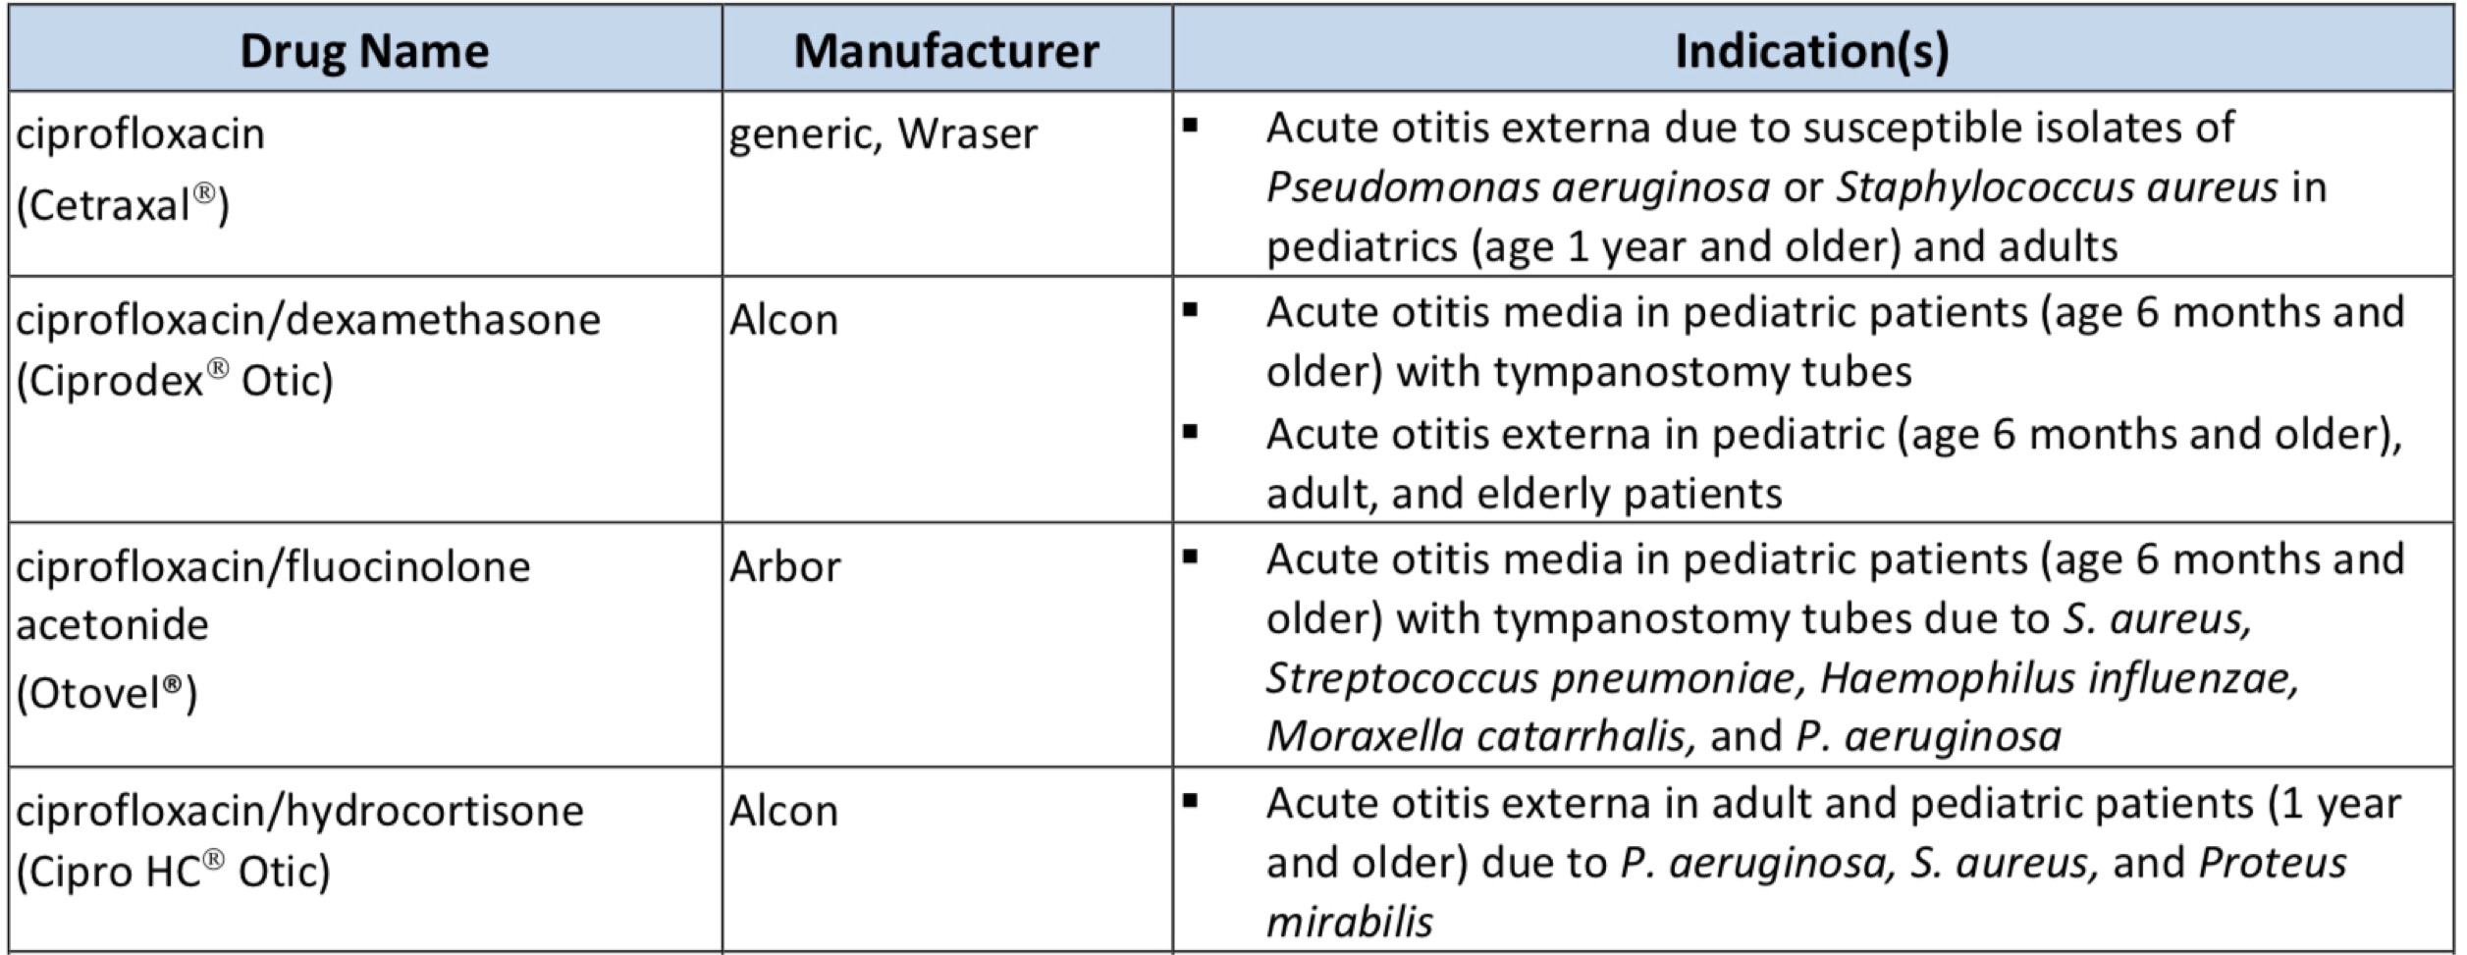
Otic Antibiotics
PRODUCT LIST AND FDA-APPROVED INDICATIONS

Slide 133
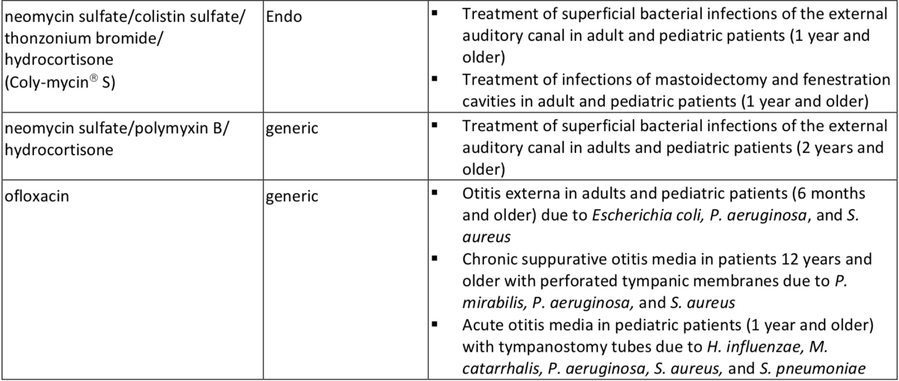
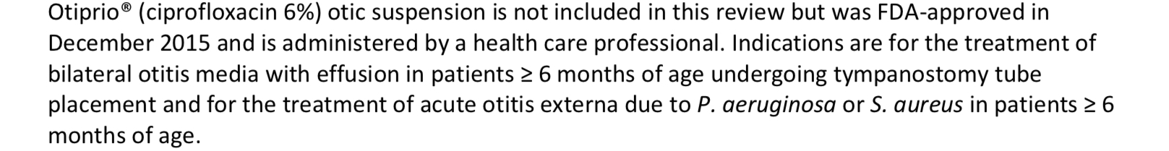
Otic Antibiotics

Slide 134
Otic Antibiotics
The American Academy of Otolaryngology – Head and Neck Surgery Foundation (AAO-HNSF) guidelines for the management of acute otitis externa (AOE) in patients over 2 years of age recommend topical preparations for initial therapy of diffuse, uncomplicated AOE
A topical aminoglycoside combined with a second antibiotic and a topical steroid, such as the combination of neomycin, polymyxin B, and hydrocortisone is commonly prescribed to treat AOE
While the addition of a corticosteroid may be of benefit in reducing inflammation, some consider the use of corticosteroids unnecessary

Slide 135
Otic Antibiotics
For acute otitis media, consensus guidelines recommend systemic antibiotics, usually amoxicillin as first line therapy
Otic antibiotics provide an alternative to other topical antibiotics in the treatment of acute otitis media in children with tympanostomy tubes
For chronic suppurative otitis media (CSOM), aminoglycosides or fluoroquinolones can be used
Aminoglycosides are not recommended to be used if the tympanic membrane is perforated; fluoroquinolones are not associated with ototoxicity, and ofloxacin is considered safe in cases of a perforated tympanic membrane

Slide 136
Otic Antibiotics
Product/Guideline Updates:
A generic for Ciprodex otic suspension is now available

Slide 137
Pulmonary Arterial Hypertension (PAH) Agents, Oral and Inhaled

Slide 138
Pulmonary Arterial Hypertension (PAH) Agents, Oral and Inhaled
Drug | Manufacturer | Indication(s)
Oral Agents
ambrisentan (Letairis®) | generic, Gilead | Treatment of pulmonary arterial hypertension (World Health Organization [WHO] Group I) to improve exercise ability and delay clinical worsening In combination with tadalafil to reduce the risks of disease progression and hospitalization for worsening PAH, and to improve exercise ability
bosentan (Tracleer®) | generic, Actelion | Treatment of pulmonary arterial hypertension (WHO Group I) in patients with WHO Class II to IV symptoms, to improve exercise ability and decrease clinical worsening Treatment of idiopathic or congenital PAH to improve pulmonary vascular resistance (PVR) in pediatric patients age 3 years and older which is expected to result in an improvement in exercise ability
macitentan (Opsumit®) | Actelion | Treatment of pulmonary arterial hypertension (WHO Group I) to delay disease progression which includes death, initiation of intravenous (IV) or subcutaneous (SC) prostanoids, or clinical worsening; Opsumit also reduced hospitalization for PAH
riociguat (Adempas®) | Bayer | Persistent/recurrent chronic thromboembolic pulmonary hypertension (CTEPH) (WHO Group IV) after surgical treatment or inoperable CTEPH to improve exercise capacity and WHO functional class Pulmonary arterial hypertension (WHO Group I) to improve exercise capacity, improve WHO functional class and to delay clinical worsening

Slide 139
Pulmonary Arterial Hypertension (PAH) Agents, Oral and Inhaled
selexipag (Uptravi®) | Actelion | Treatment of pulmonary arterial hypertension (WHO Group I) to delay disease progression and reduce the risk of hospitalization for PAH
sildenafil (Revatio®) | generic, Pfizer | Treatment of pulmonary arterial hypertension (WHO Group I) to improve exercise ability and delay clinical worsening
tadalafil (Adcirca®) | generic, Eli Lilly | Treatment of pulmonary arterial hypertension (WHO Group I) to improve exercise ability
treprostinil (Orenitram®) | United Therapeutics | Treatment of pulmonary arterial hypertension (WHO Group I) to delay disease progression and to improve exercise capacity
Inhalation Agents
iloprost (Ventavis®) | Actelion | Treatment of pulmonary arterial hypertension (WHO Group I) to improve a composite endpoint consisting of exercise tolerance, symptoms (NYHA Class), and lack of deterioration
treprostinil (Tyvaso®) | United Therapeutics | Treatment of pulmonary arterial hypertension (WHO Group I) to increase exercise ability

Slide 140
Pulmonary Arterial Hypertension (PAH) Agents,
Oral and Inhaled
The treatment for pulmonary arterial hypertension (PAH) is complex
A trial of high dose oral calcium channel blockers (CCB), such as amlodipine, diltiazem, or nifedipine, is recommended in patients with a positive acute vasoreactive test
Alternative or additional PAH therapy should be initiated if improvement to WHO FC I or II are not seen after the trial of a CCB
The 2018 updated American College of Chest Physicians (CHEST) guidelines on therapy for pulmonary arterial hypertension in adults provide treatment recommendations based on World Health Organization (WHO) functional class (FC) for patients who are not candidates for, or who have failed, high-dose oral calcium channel blocker (CCB) therapy

Slide 141
Pulmonary Arterial Hypertension (PAH) Agents, Oral and Inhaled
In treatment-naïve patients with WHO FC II or WHO FC III without rapid disease progression or poor prognosis, initial combination therapy with ambrisentan and tadalafil is suggested
Monotherapy with ambrisentan, bosentan, sildenafil, macitentan, tadalafil, or riociguat is considered an alternative in patients who are unwilling to take or cannot tolerate combination therapy
For treatment-naïve patients with WHO FC IV, initial therapy with a parenteral prostanoid agent is recommended
If the patient cannot comply with parenteral administration, an inhaled prostanoid in combination with an oral endothelin receptor antagonist (ERA) or an oral phosphodiesterase type-5 (PDE-5) inhibitor are alternatives

Slide 142
Pulmonary Arterial Hypertension (PAH) Agents, Oral and Inhaled
If symptoms still remain during treatment with an oral ERA or PDE-5 inhibitor, addition of an inhaled prostanoid is suggested
In patients with WHO FC III and continued disease progression while on oral mono- or combination therapy, addition of a parenteral or inhaled prostanoid may be considered
In patients with WHO FC III or IV and an inadequate response to initial therapy with mono- or combination therapy, a second or third class of PAH agents should be added
The European Society of Cardiology (ESC) and the European Respiratory Society (ERS) 2015 recommendations for the diagnosis and treatment of pulmonary hypertension include Selexipag as an option for monotherapy or in combination with an ERA and/or PDE-5 inhibitor in patients with WHO FC II or III
ESC/ERS also include oral treprostinil as an option for monotherapy in patients with WHO FC III

Slide 143
Thrombopoiesis Stimulating Proteins

Slide 144
Thrombopoiesis Stimulating Proteins
Drug | Manufacturer | Indication(s)
avatrombopag (Doptelet®) | Akarx | Treatment of thrombocytopenia in adults with chronic immune thrombocytopenia (ITP) who have had an insufficient response to a previous treatment Treatment of thrombocytopenia in adult patients with chronic liver disease (CLD) who are scheduled to undergo a procedure Avatrombopag should not be used in an attempt to normalize platelet counts in patients with chronic liver disease (CLD)
eltrombopag (Promacta®) | Novartis | Treatment of thrombocytopenia in adult and pediatric patients ≥ 1 year of age with chronic immune thrombocytopenia (ITP) who have had an insufficient response to corticosteroids, immunoglobulins, or splenectomy Eltrombopag should only be used in patients with ITP whose degree of thrombocytopenia and clinical condition increase the risk for bleeding Treatment of thrombocytopenia in patients with chronic hepatitis C (HCV) to allow the initiation and maintenance of interferon-based therapy Eltrombopag should be used only in patients with chronic HCV whose degree of thrombocytopenia prevents the initiation of interferon-based therapy or limits the ability to maintain interferon-based therapy Safety and efficacy have not been established in combination with direct acting antiviral agents approved for treatment of chronic HCV infection Eltrombopag should not be used in an attempt to normalize platelet counts In combination with standard immunosuppressive therapy for first-line treatment of adult and pediatric patients ≥ 2 years of age with severe aplastic anemia Treatment of patients with severe aplastic anemia who have had an insufficient response to immunosuppressive therapy Eltrombopag is not indicated for the treatment of myelodysplastic syndrome (MDS)

Slide 145
Thrombopoiesis Stimulating Proteins
fostamatinib disodium hexahydrate (Tavalisse™) | Rigel | Treatment of thrombocytopenia in adult patients with chronic immune thrombocytopenia (ITP) who have had an insufficient response to a previous treatment
lusutrombopag (Mulpleta®) | Shionogi | Treatment of thrombocytopenia in adult patients with CLD who are scheduled to undergo a procedure Lusutrombopag should not be used in attempt to normalize platelet counts in patients with CLD
romiplostim (Nplate®) | Amgen | Treatment of pediatric patients ≥ 1 year of age with immune thrombocytopenia (ITP) for ≥ 6 months who have had an insufficient response to corticosteroids, immune globulins, or splenectomy Treatment of adults with chronic immune thrombocytopenia (ITP) who have an insufficient response with corticosteroids, immunoglobulins, or splenectomy Romiplostim is not indicated to treat thrombocytopenia due to myelodysplastic syndrome (MDS) or any cause of thrombocytopenia other than chronic ITP Romiplostim should only be used in patients with ITP whose degree of thrombocytopenia and clinical condition increases their risk for bleeding Romiplostim should not be used in an attempt to normalize platelet counts

Slide 146
Thrombopoiesis Stimulating Proteins
Thrombocytopenia occurs in 64% to 84% of patients with chronic liver disease (CLD) with cirrhosis or fibrosis and approximately 6% of CLD patients without cirrhosis
In 2019, the international consensus report on primary ITP provided a review of updated therapies for the management of ITP in children and adults
Per the consensus, treatment decisions should be individualized depending on the extent of bleeding, platelet count, patient age, presence of fatigue, assessment of risk factors for bleeding, patient preference, and access to care
Corticosteroids continue to be first-line therapy for the treatment of ITP in adults
Subsequent treatments with strong evidence include rituximab, the thrombopoietin receptor agonists (TPO-RAs) eltrombopag (Promacta), avatrombopag (Doptelet), and romiplostim (Nplate), as well as fostamatinib (Tavalisse)

Slide 147
Thrombopoiesis Stimulating Proteins
Subsequent therapies with less robust evidence include azathioprine, cyclophosphamide, cyclosporine, danazol, dapsone, mycophenolate mofetil, and vinca alkaloids
Use of lusutrombopag (Mulpleta) is not addressed in the updated guidelines
The 2019 updated American Society of Hematology (ASH) evidence-based practice guidelines for the management of immune thrombocytopenia recommends observation or corticosteroids based on platelet count
Treatment decisions should consider the severity of thrombocytopenia, comorbid conditions, use of antiplatelet or anticoagulant drugs, upcoming procedures, and the patient’s age
For adults with ITP for ≥ 3 months who are corticosteroid-dependent or unresponsive to steroids, treatment with eltrombopag or romiplostim is suggested (very low certainty)

Slide 148
Thrombopoiesis Stimulating Proteins
Either IVIG or anti-D may be used as a first-line therapy if corticosteroids are contraindicated (grade 2C)
Thrombopoietin receptor agonists may be considered for patients at risk for bleeding who have failed at least 1 other therapy and who relapse after splenectomy or have a contraindication to splenectomy (grade 1B)
Thrombopoietin receptor agonists may also be considered in patients at risk for bleeding who have not had a splenectomy and who have failed corticosteroids or IVIG (grade 2C)
Pharmacotherapy for aplastic anemia includes immunosuppressive agents, hematopoietic growth factors, and fludarabine. Promacta is also indicated to treat first-line and refractory severe aplastic anemia (including in pediatric patients), but it carries a boxed warning regarding the increased risk for hepatic decompensation and death when used in combination with interferon and ribavirin

Slide 149
Thrombopoiesis Stimulating Proteins
Monotherapy with hematopoietic growth factors is not recommended for newly diagnosed patients
Additional research is needed to further evaluate newer agents, such as avatrombopag and fostamatinib.
Lusutrombopag is not addressed in the updated guidelines
In newly diagnosed children with non-life-threatening mucosal bleeding and/or decreased health-related quality of life (HRQoL), prednisone is suggested rather than IVIG or anti-D
If these patients are unresponsive to first-line treatment, TPO-RAs are suggested

Slide 150
Ulcerative Colitis Agents

Slide 151
Ulcerative Colitis Agents
Drug | Manufacturer | Indication(s)
 |  | Treatment | Maintenance
Oral Prodrug Forms
balsalazide (Colazal®) | generic, Salix | Mild to moderately active ulcerative colitis (UC) in patients ≥ 5 years | --
olsalazine (Dipentum®) | Meda/Mylan | -- | Maintenance of remission of UC in patients intolerant of sulfasalazine
sulfasalazine (Azulfidine®, Azulfidine EN-tabs®) | generic*, Pfizer | Mild to moderately active UC Adjunctive therapy in severe UC | Maintenance of remission of UC
 |  | Other: Enteric-coated tablets are indicated in patients with UC who cannot take uncoated sulfasalazine tablets because of gastrointestinal (GI) intolerance Treatment of rheumatoid arthritis that has not responded adequately to salicylates or other nonsteroidal anti-inflammatory agents (NSAIDs) Treatment of pediatric patients with polyarticular juvenile rheumatoid arthritis who have not responded adequately to salicylates or other NSAIDs

Slide 152
Ulcerative Colitis Agents
Oral Delayed-Release Forms
mesalamine delayed-release tablets (Asacol® HD) | generic, Allergan | Moderately active UC | --
mesalamine delayed-release capsules (Delzicol®) | generic, Allergan | Mild to moderately active UC in patients ≥ 5 years | Maintenance of remission of UC in adults
mesalamine MMX delayed-release tablets (Lialda®) | generic, Shire US | Mild to moderately active UC in pediatric patients ≥ 24 kg and adults | Maintenance of remission of mild to moderately active UC in adults
mesalamine extended-release capsules (Pentasa®) | Shire US | Mild to moderately active UC | --
mesalamine extended-release capsules (Apriso®) | generic, Salix | -- | Maintenance of remission of UC in adults

Slide 153
Ulcerative Colitis Agents
Rectal Forms
budesonide rectal foam (Uceris®) | Salix | Mild to moderate active UC extending 40 cm from the anal verge | --
mesalamine enemas (Rowasa®) | Meda/Mylan | Mild to moderately active distal UC, proctosigmoiditis, or proctitis | --
mesalamine enemas sulfite-free (sfRowasa®) | generic, Meda/Mylan | Mild to moderately active distal UC, proctosigmoiditis, or proctitis | --
mesalamine suppositories (Canasa®) | generic, Allergan | Active ulcerative proctitis | --
Oral Corticosteroids
budesonide extended-release tablets (Uceris®) | generic, Santarus | Mild to moderately active UC | --

Slide 154
Ulcerative Colitis Agents
Ulcerative colitis (UC) is a chronic inflammatory disease primarily affecting the colon and rectum
It is characterized by superficial infiltration of the bowel wall by inflammatory white cells, resulting in multiple mucosal ulcerations and crypt abscesses
Aminosalicylates remain first-line treatment options for mild to moderate active UC
The rectal mesalamine products achieve high luminal concentrations of the active component, 5-aminosalicylic acid (5-ASA, mesalamine), while minimizing adverse events from systemic absorption
Second-line therapy with a course of oral or rectal steroids is indicated for induction therapy in patients with mild to moderate disease who do not respond to oral and rectal mesalamine agents or in patients with moderate to severe disease
In patients with severe or refractory UC symptoms, oral corticosteroids are indicated

Slide 155
Ulcerative Colitis Agents
Several injectable tumor necrosis factor (TNF)-inhibitors (infliximab [Remicade®], adalimumab [Humira®], and golimumab [Simponi Aria®]) are approved for inducing and maintaining clinical response/remission in patients with moderate to severe active UC who fail conventional therapy or who are considered at high-risk for colectomy
Vedolizumab (Entyvio®) is an intravenous (IV) integrin receptor antagonist indicated in adults for the treatment of moderately to severely active UC and moderately to severely active Crohn’s disease
The injectable interleukin-12/interleukin-23 antagonist, ustekinumab (Stelara®), received FDA approval for the treatment of adults with moderately to severely active UC in 2019
The oral Janus kinase (JAK) inhibitor tofacitinib (Xeljanz®, Xeljanz XR) is indicated for adults with moderately to severely active UC, specifically for patients with an inadequate response or intolerance to TNF inhibitors

Slide 156
Ulcerative Colitis Agents
The 2013 American Academy of Family Physicians (AAFP) guidelines for the diagnosis and treatment of UC
Recommend 5-ASA (mesalamine) via suppository or enema as first-line for patients with proctitis or proctosigmoiditis, respectively
Patients unable to tolerate rectally administered 5-ASA therapy may try oral preparations, although response times and remission rates may not be as favorable
Budesonide (Uceris), adalimumab, golimumab, vedolizumab, ustekinumab, and tofacitinib were not FDA-approved to treat UC at the time these guidelines were developed
The 2019 American College of Gastroenterology (ACG) clinical guidelines state treatment selection for UC should be based not only on inflammatory activity but also on disease prognosis
In general, mildly active proctitis and distal UC are treated with rectal 5-ASA
Oral 5-ASA agents are used, if needed, as add-on for distal UC or to treat extensive disease

Slide 157
Ulcerative Colitis Agents
In patients with mildly active UC who are intolerant or non-responsive to 5-ASA, oral budesonide MMX is recommended to induce remission
Moderately active UC should be treated with oral 5-ASA or budesonide
In patients with moderately to severely active UC, the ACG recommends induction of remission using systemic corticosteroids, anti-TNF therapy, vedolizumab, or tofacitinib
Per the 2020 American Gastroenterological Association (AGA) practice guidelines, long-term management of patients with moderate to severe UC can include medications from the following classes: TNF-alpha antagonists, immunomodulators (e.g., thiopurines [azathioprine], methotrexate), the anti-integrin agent vedolizumab, and JAK inhibitors (e.g., tofacitinib)
With the exception of corticosteroids or cyclosporine, if the agent selected for inducing remission is effective, it is usually continued as maintenance therapy
Methotrexate monotherapy is suggested against use for induction and maintenance of remission

Slide 158
New Drug Reviews
Hind Douiki, Pharm.D.

Slide 159
New Products
Ongentys (opicapone)
Enspryng (satralizumab-mwge)
Bafiertam (monomethyl fumarate)
Lampit (nifurtimox)
Xywav (calcium, magnesium, potassium & sodium oxybates)
Zeposia (ozanimod)

Slide 160
Ongentys (opicapone)
Indicated as adjunctive treatment to levodopa/carbidopa in patients with Parkinson’s disease (PD) experiencing “off” episodes
The recommended dosage is 50 mg administered orally once daily at bedtime
Available as 25 mg and 50 mg capsules
Contraindications
  Concomitant use of non-selective monoamine oxidase (MAO) inhibitors
  History of pheochromocytoma, paraganglioma, or other catecholamine secreting neoplasms
Warnings:
  Cardiovascular Effects with Concomitant Use of Drugs Metabolized by Catechol-O-Methyltransferase (COMT)
  Falling Asleep During Activities of Daily Living
  Hypotension/Syncope
  Dyskinesia
  Hallucinations and Psychosis
  Impulse Control/Compulsive Disorders
  Withdrawal-Emergent Hyperpyrexia and Confusion

Slide 161
Ongentys (opicapone)
Most common adverse reactions (≥4% and > placebo):
  Dyskinesia, constipation, blood creatine kinase increased, hypotension/syncope, and decrease in weight
The FDA approval of Ongentys was based on two multinational Phase III clinical studies, BIPARK-1 and BIPARK-2.
In the BIPARK-1 trial, approximately 600 patients with Parkinson's disease and motor fluctuations received one of three doses of Ongentys (5 mg, 25 mg or 50 mg), placebo or 200 mg doses of the COMT inhibitor entacapone for 14 or 15 weeks
In the BIPARK-2 trial, approximately 400 patients received one of two doses of Ongentys (25 mg or 50 mg) or placebo for 14 or 15 weeks
Both studies included a one-year open-label extension
Data from both trials showed that Ongentys 50 mg significantly reduced "off" time from baseline to week 14 or 15 compared to placebo
"On" time without troublesome dyskinesia also increased from baseline to week 14 or 15 compared to placebo

Slide 162
Enspryng (satralizumab-mwge)
Indicated for the treatment of neuromyelitis optica spectrum disorder (NMOSD) in adult patients who are anti-aquaporin-4 (AQP4) antibody positive
The recommended loading dosage of Enspryng for the first three administrations is 120 mg by subcutaneous injection at Weeks 0, 2, and 4, followed by a maintenance dosage of 120 mg every 4 weeks
Hepatitis B virus, tuberculosis, and liver transaminase screening is required before the first dose. An active infection should be determined prior to each use
Available as 120 mg/mL in a single-dose prefilled syringe
Contraindications
  Hepatitis B infection
  Active or untreated latent tuberculosis
  Known hypersensitivity to satralizumab or any of the inactive ingredients

Slide 163
Enspryng (satralizumab-mwge)
Warnings include infections, Elevated Liver Enzymes, and Decreased Neutrophil Counts
Adverse reactions (incidence at least 15%):
  nasopharyngitis, headache, upper respiratory tract infection, gastritis, rash, arthralgia, extremity pain, fatigue, and nausea
No comparative data are available
The FDA approval of Enspryng was based on results from two randomized controlled Phase III clinical trials, the SAkuraStar and SAkuraSky studies
SAkuraStar was a multicenter, randomized, double-blind, placebo-controlled study to evaluate the efficacy and safety of Enspryng monotherapy
Ninety-five adult patients were randomized to either of the following two treatment groups in a 2:1 ratio: Enspryng (120 mg) or placebo

Slide 164
Enspryng (satralizumab-mwge)
Both treatments were administered subcutaneously at week 0, 2, and 4; the subsequent treatment was continued at 4-week intervals.
The double-blind treatment period ended at 1.5 years after the enrollment of the last patient
The primary endpoint is the time to first protocol-defined relapse (PDR), adjudicated by an independent review committee in the double-blind period
The time to first relapse was significantly longer in Enspryng treated patients compared to patients who received placebo (risk reduction 55%)
In the anti-AQP4 antibody positive population, there was a 74% risk reduction
There was no evidence of a benefit in the anti-AQP4 antibody negative patients

Slide 165
Enspryng (satralizumab-mwge)
SAkuraSky was a multicenter, randomized, double-blind, placebo-controlled study to evaluate the efficacy and safety of Enspryng added to baseline immunosuppressant therapy in patients with NMOSD
Seventy-six adult patients were randomized to either of the following two treatment groups in a 1:1 ratio: Enspryng (120 mg) or placebo added to baseline therapy (azathioprine, mycophenolate mofetil and/or corticosteroids)
Both treatments were administered subcutaneously at week 0, 2, and 4; the subsequent treatment was continued at 4-week intervals
The double-blind treatment period ended when patients experienced a PDR; the study ended when the total number of PDRs reached 26
The primary endpoint was the time to first PDR as adjudicated by an independent review committee in the double-blind period
The time to the first confirmed relapse was significantly longer in patients treated with Enspryng compared to patients who received placebo (risk reduction 62%)
In the anti-AQP4 antibody positive population, there was a 78% risk reduction; there was no evidence of a benefit in the anti-AQP4 antibody negative patients

Slide 166
Bafiertam (monomethyl fumarate)
Indicated for the treatment of relapsing forms of multiple sclerosis (MS), to include clinically isolated syndrome, relapsing-remitting disease, and active secondary progressive disease, in adults
Following oral administration, dimethyl fumarate is rapidly hydrolyzed and converted to the active metabolite, monomethyl fumarate
The starting dose is 95 mg orally twice a day for 7 days; maintenance dose is 190 mg orally twice a day
Blood tests are required prior to initiation of Bafiertam
Available as 95 mg delayed-release capsules
Contraindications:
  known hypersensitivity to monomethyl fumarate, dimethyl fumarate, diroximel fumarate, or any of the excipients of Bafiertam
  Co-administration with dimethyl fumarate or diroximel fumarate

Slide 167
Bafiertam (monomethyl fumarate)
Warnings:
  Anaphylaxis and Angioedema
  Progressive Multifocal Leukoencephalopathy (PML)
  Herpes zoster and other serious opportunistic infections
  Lymphopenia
  Liver Injury
Adverse reactions (≥10% and ≥2% more than placebo) were flushing, abdominal pain, diarrhea, and nausea
Bafiertam was approved via the 505(b)(2) pathway
Bioavailability studies in healthy subjects compared monomethyl fumarate administered orally as 190 mg (two 95 mg delayed-release capsules) in a fasting state to 240 mg orally of dimethyl fumarate delayed-release capsule
The median time to maximum concentration (Tmax), maximum plasma concentration (Cmax), and overall exposure as measured by the area-under-the-curve (AUC) were found to be bioequivalent

Slide 168
Lampit (nifurtimox)
Indicated in pediatric patients(birth to less than 18 years of age and weighing at least 2.5 kg) for the treatment of Chagas disease (American Trypanosomiasis), caused by Trypanosoma cruzi
This indication is approved under accelerated approval; continued approval for this indication may be contingent upon verification and description of clinical benefit in a confirmatory trial(s)
Total Daily Dose is 8 to 10 mg/kg for patients weighing 40 kg or greater; 10 to 20 mg/kg for patients weighing Less than 40 kg
Dose is to be administered orally three times daily with food for 60 days
Available as 30 mg and 120 mg tablets functionally scored
Contraindications
  Known hypersensitivity to nifurtimox or to any of the excipients in Lampit
  Alcohol consumption during treatment

Slide 169
Lampit (nifurtimox)
Warnings:
  Potential for Genotoxicity and Carcinogenicity
  Embryo-Fetal Toxicity
  Worsening Neurological and Psychiatric Conditions
  Hypersensitivity
  Decreased Appetite and Weight Loss
  Porphyria
The most frequently reported adverse reactions (≥5%) are vomiting, abdominal pain, headache, decreased appetite, nausea, pyrexia, and rash
The FDA approval was based on results from the Chagas disease in children treated with nifurtimox study

Slide 170
Lampit (nifurtimox)
The prospective, randomized (to dosing regimen), double-blind study assessed the efficacy, safety, and pharmacokinetics of nifurtimox in 330 children with Chagas disease
The study was conducted at 25 investigational sites in Argentina, Bolivia, and Colombia between 2016 and 2018
In the study, 330 pediatric patients with serologic evidence of T. cruzi infection (without Chagas disease-related cardiovascular and/or gastrointestinal symptoms) were randomly assigned in a 2:1 ratio to receive either a 60-day or a 30-day Lampit treatment regimen
Participants were followed up for one year after end of treatment
The results showed superiority in favor of the nifurtimox 60-day arm compared to the nifurtimox 30-day arm (not an approved dosing regimen)

Slide 171
Xywav (calcium, magnesium, potassium & sodium oxybates)
Indicated for the treatment of cataplexy or excessive daytime sleepiness (EDS) in patients 7 years of age and older with narcolepsy
Is a CIII controlled substance
Initial adult dosage is 4.5 g per night orally, divided into two doses (at bedtime and 2.5 to 4 hours later), titrated to effect in increments of up to 1.5 g per night per week. Recommended dosage range is 6 g to 9 g orally per night
For pediatric patients (7 years of age and older), the recommended starting dosage, titration regimen, and maximum total nightly dose are based on body weight
Both doses should be prepared prior to bedtime and each dose is to be diluted with approximately ¼ cup of water in pharmacy-provided containers
Available as 0.5 g/mL solution

Slide 172
Xywav (calcium, magnesium, potassium & sodium oxybates)
Contraindications
  In combination with sedative hypnotics or alcohol
  Succinic semialdehyde dehydrogenase deficiency
Boxed Warnings:
  CNS Depression
  Abuse and Misuse
Additional warnings:
  CNS depression
  hazardous activities requiring complete mental alertness or motor coordination
  Depression and suicidality
  Confusion/Anxiety
  Parasomnias

Slide 173
Xywav (calcium, magnesium, potassium & sodium oxybates)
Most common adverse reactions in adults (≥5%) were headache, nausea, dizziness, decreased appetite, parasomnia, diarrhea, hyperhidrosis, anxiety, and vomiting
In a pediatric study with sodium oxybate (same active moiety as XYWAV), the most common adverse reactions (≥5%) were nausea, enuresis, vomiting, headache, weight decreased, decreased appetite, dizziness, and sleepwalking
The FDA approval of Xywav was based on two phase 3 clinical trials: one in adults and one in pediatrics.
The Adults trial was global, double-blind, placebo-controlled, randomized-withdrawal, and multicentered
The study evaluated the efficacy and safety of Xywav in the treatment of cataplexy and EDS in adults with narcolepsy

Slide 174
Xywav (calcium, magnesium, potassium & sodium oxybates)
The primary endpoint was the change in the weekly number of cataplexy attacks; the key secondary endpoint was the change in the Epworth Sleepiness Scale (ESS) score with Xywav compared to placebo
The study enrolled 201 participants and randomized 134 participants, comprising a heterogeneous population, which included those previously treated with sodium oxybate and naïve to sodium oxybate, with or without other anti-cataplectic treatments
During the double-blind withdrawal period, there was a significant increase in median weekly number of cataplexy attacks in participants randomized to placebo compared with participants randomized to Xywav
At the end of the double-blind withdrawal period, there was a significant increase in median ESS scores in participants randomized to placebo compared with participants randomized to Xywav

Slide 175
Xywav (calcium, magnesium, potassium & sodium oxybates)
The effectiveness of Xywav in pediatric patients is based upon a clinical study in patients treated with Xyrem
The Pediatrics trial established the effectiveness of Xyrem in the treatment of cataplexy and excessive daytime sleepiness in pediatric patients 7 years of age and older with narcolepsy in a double-blind, placebo-controlled, randomized-withdrawal study
The study was conducted in 106 pediatric patients (median age: 12 years; range: 7 to 17 years) with a baseline history of at least 14 cataplexy attacks in a typical 2-week period prior to any treatment for narcolepsy symptoms
Of the 106 patients, 2 did not receive study drug and 63 patients were randomized 1:1 either to continued treatment with Xyrem or to placebo
Randomization to placebo was stopped early as the efficacy criterion was met at the pre-planned interim analysis

Slide 176
Xywav (calcium, magnesium, potassium & sodium oxybates)
The primary efficacy measure was the change in frequency of cataplexy attacks
Pediatric patients taking stable dosages of Xyrem who discontinued this treatment and were randomized to placebo during the double-blind treatment period experienced a statistically significant increase in weekly cataplexy attacks compared with patients who were randomized to continue treatment with Xyrem
Patients randomized to receive placebo during the double-blind treatment period experienced a statistically significant worsening of EDS compared with patients randomized to continue receiving Xyrem

Slide 177
Zeposia (ozanimod)
Indicated for the treatment of relapsing forms of multiple sclerosis (MS), to include clinically isolated syndrome, relapsing-remitting disease, and active secondary progressive disease, in adults
Titration is required for treatment initiation (days 1-4: 0.23 mg once daily; days 5-7: 0.46 mg once daily; day 8 and thereafter: 0.92 m g once daily). The recommended maintenance dosage is 0.92 mg orally once daily
Available as 0.23 mg, 0.46 mg, and 0.92 mg capsules
Assessments required prior to initiating:
  Complete Blood Count
  Cardiac Evaluation
  Liver Function Tests
  Ophthalmic Assessment
  Current or Prior Medications
  Vaccinations

Slide 178
Zeposia (ozanimod)
Contraindications:
  In the last 6 months, experience of myocardial infarction, unstable angina, stroke, transient ischemic attack, decompensated heart failure requiring hospitalization, or Class III or IV heart failure
  Presence of Mobitz type II second-degree or third degree atrioventricular (AV) block, sick sinus syndrome, or sino-atrial block, unless the patient has a functioning pacemaker
  Severe untreated sleep apnea
  Concomitant use of a monoamine oxidase inhibitor
Warnings:
  Infections Increased Blood Pressure Bradyarrhythmia and Atrioventricular Conduction Delays Respiratory Effects
  Liver Injury Macular Edema
  Fetal Risk

Slide 179
Zeposia (ozanimod)
Most common adverse reactions (incidence ≥4%) were upper respiratory infection, hepatic transaminase elevation, orthostatic hypotension, urinary tract infection, back pain, and hypertension
The FDA approval of Zeposia was based on the randomized, active-controlled Phase 3 SUNBEAM (safety and efficacy of Zeposia versus interferon beta-1a in relapsing multiple sclerosis) and RADIANCE (safety and efficacy of the selective sphingosine 1-phosphate receptor modulator Zeposia in relapsing multiple sclerosis) Part B clinical trials
Both head-to-head trials compared Zeposia to Avonex (interferon beta-1a)
SUNBEAM was a pivotal, multicenter, randomized, double-blind, double-dummy, active-controlled trial evaluating the efficacy, safety and tolerability of oral Zeposia (0.92 mg, equivalent to 1 mg) against weekly intramuscular Avonex (interferon beta-1a) for at least a 12-month treatment period

Slide 180
Zeposia (ozanimod)
The study included 1,346 people with RMS across 152 sites in 20 countries
The primary endpoint was annualized relapse rates (ARR) during the treatment period
RADIANCE Part B was a pivotal, multicenter, randomized, double-blind, double-dummy, active-controlled trial evaluating the efficacy, safety and tolerability of oral Zeposia (0.92 mg, equivalent to 1 mg) against weekly intramuscular Avonex (interferon beta-1a) over a 24-month treatment period
The study included 1,320 people with RMS across 150 sites in 21 countries.
The primary endpoint of the trial was ARR over 24 months
Zeposia demonstrated a relative reduction in ARR versus Avonex of 48% through one year and 38% at two years, respectively

Slide 181
Zeposia (ozanimod)
At one year, treatment with Zeposia reduced the number of T1-weighted gadolinium-enhanced (GdE) brain lesions more than Avonex (0.16 vs 0.43), a relative reduction of 63%, and reduced the number of new or enlarging T2 lesions (1.47 vs. 2.84), a relative reduction of 48%
At two years, treatment with Zeposia reduced the number of T1-weighted gadolinium-enhanced (GdE) brain lesions more than Avonex (0.18 vs 0.37), a relative reduction of 53%
Zeposia also reduced the number of new or enlarging T2 lesions vs Avonex (1.84 vs 3.18), a relative reduction of 42%
There was no statistically significant difference in the three-month and six-month confirmed disability progression between ZEPOSIA- and AVONEX- treated patients over two years

Slide 182
Review of Studies and Guidelines Comparing HIV Single Tablet Daily Regimens (STR) to Multiple Tablet Daily Regimens (MTR)
Hind Douiki, PharmD, Magellan

Slide 183
P&T Request Related to Antiretroviral Class
Studies have been submitted suggesting antiretroviral single tablet daily regimens (STRs) positively correlate with improved medication adherence and viral suppression
A request has been submitted to AHCCCS to change the PDL status of STRs to open access which would result in adding the following agents to the PDL without PA:
  Dovato: dolutegravir (Tivicay) and lamivudine (Epivir)
  Symtuza: darunavir/cobicistat (Prezcobix) and emtricitabine/tenofovir (Descovy)
  Juluca: dolutegravir (Tivicay) and rilpivirine (Edurant)

Slide 184
HIV Treatment Guidelines re: STR vs. MTR

Slide 185
National Institutes of Health (NIH)
HIV Treatment Guidelines
Regimen selection should consider not only pill burden (pill burden is not explicitly defined) but also cost and access
Use of generics may necessitate modest pill burden increases without changes in drug frequency
https://clinicalinfo.hiv.gov/en/guidelines/adult-and-adolescent-arv/whats-new-guidelines

Slide 186
International Antiviral Society (IAS) Guidelines
Optimal regimens are those with a high rate of viral suppression, minimal toxicity, low pill burden (although pill burden is not explicitly defined), and few drug interactions
Not all first-line regimens are single-tablet regimens since several different factors are considered
Optimal regimens are those with a high rate of viral suppression, minimal toxicity, low pill burden, and few drug interactions;
Similar to NIH, the IAS guidelines also discuss cost considerations
Strategies are addressed to reduce costs, stating there is a correlation with higher out-of-pocket costs and lower adherence
https://www.iasusa.org/wp-content/uploads/guidelines/arv/arv_2020.pdf

Slide 187
Evaluations of Studies: STR vs. MTR

Slide 188
Single and Multiple Tablet HIV Drug Study
Observations
Multiple tablet regimens were evaluated from a frequency perspective and not defined as taking more than one tablet once daily;
With the retrospective review of all baseline variables influencing outcome, adjustments were not completed for variables between cohorts;
Lack of complete data on prior treatments;
Studies did not always know whether the participant was the treatment naïve;
Participant database may not be representative of the US HIV populations as a whole.

Slide 189
Single and Multiple Tablet HIV Drug Study Observations
Pill burden is mentioned in several places, but it is not explicitly defined;
Low pill burden, even if it is not one pill once daily, is associated with higher levels of adherence;
Data to support or refute the superiority of a STR vs. MTR are limited;
Use of generics may necessitate modest increases in pill burden without changes in drug frequency.
Overall, recommendations include following general guidance for initiating a regimen, some of which are not single tablet regimens, but also tailoring to the individual patient. Based on this, the studies do not seem to imply one tablet once a day is the best choice for all patients.

Slide 190
Applicable Federal Legislation Related to PDL Management

Slide 191
Section 1927 of the Social Security Act
Federal Legislation for payment of Medicaid Covered Outpatient Drugs
Manufacturers must sign the CMS Federal Rebate Agreement for drugs to be eligible for coverage as a Medicaid Covered Outpatient Drug
Payment for Covered Outpatient Drugs is by state and federal matching funds
SECTION (d)(1)(A) & (d)(5)
  Limitation on Coverage of Drugs
    Permissible Restrictions
    A State may subject to prior authorization any covered outpatient drug.
    A State plan under this title may require, as a condition of coverage or payment for a covered outpatient drug for which Federal financial participation is available in accordance with this section, with respect to drugs dispensed on or after July 1, 1991, the approval of the drug before its dispensing for any medically accepted indication.

Slide 192
Cost Evaluation of Removing PA from Dovato, Symtuza, and Juluca

Slide 193
Net Cost of Pharmaceutical Products to the State
Net cost to the state is defined as the final cost after rebates have been applied.
Rebates include the CMS Federal Rebate and Supplemental Rebates.
The CMS federal Unit Rebate Amount (URA) and the Average Manufacturer Price (AMP) are proprietary to CMS and states are required to maintain confidentiality.
Supplemental Rebates are contracts negotiated between the State and Manufacturer and are also confidential.
  Supplemental rebates are not applicable to the antiretroviral class.

Slide 194
Estimated Net Cost to the State for Juluca vs. Edurant & Tivicay
Juluca is a product that incorporates two products that are currently available without PA – Edurant and Tivicay.
The difference in price between the cost of one Juluca tablet vs. one tablet of Edurant and Tivicay is $24 per day.
To use 1 tablet of Juluca daily, the additional cost is $8,760 per patient annually.
If 90% of current utilizers of Edurant and Tivicay convert to Juluca, the additional annual cost to the state is estimated to be $79k - $118k (does not incorporate current utilization of Juluca).

Slide 195
Estimated Net Cost to the State for Symtuza vs.
Prezcobix & Descovy
Symtuza is a product that incorporates two products that are currently available separately without PA– Prezcobix+Descovy
The difference in price between the cost of one Symtuza tablet vs. 1 tablet of Prezcobix and Descovy is $14 per day
To use 1 tablet of Symtuza daily, the additional cost is $5,110 per patient annually
If 90% of current utilizers of Prezcobix+Descovy convert to Symtuza, the additional annual cost to the state is estimated to be $865k - $1.3M (does not incorporate current utilization of Symtuza)

Slide 196
Estimated Net Cost to the State for Dovato vs.
Dolutegravir + Lamivudine
Dovato incorporates two products that are currently available separately without PA– dolutegravir (Tivicay) + lamivudine (Epivir)
Difference in price between the cost of one Dovato tablet vs. one tablet of Lamivudine and Tivicay is $17 per day
To use 1 tablet of Dovato daily, the additional cost is $6,205 per patient annually
If 90% of current utilizers of Tivicay and Epivir convert to Dovato, the additional annual cost is estimated to be $189k - $283k (does not incorporate current utilization of Dovato)

Slide 197
Break and Executive Session

Slide 198
Public Therapeutic Class Votes

Slide 199
Meeting Adjournment
Future 2021 Meeting Dates:
  May 19, 2021
  October 18, 2021

